Slide 1
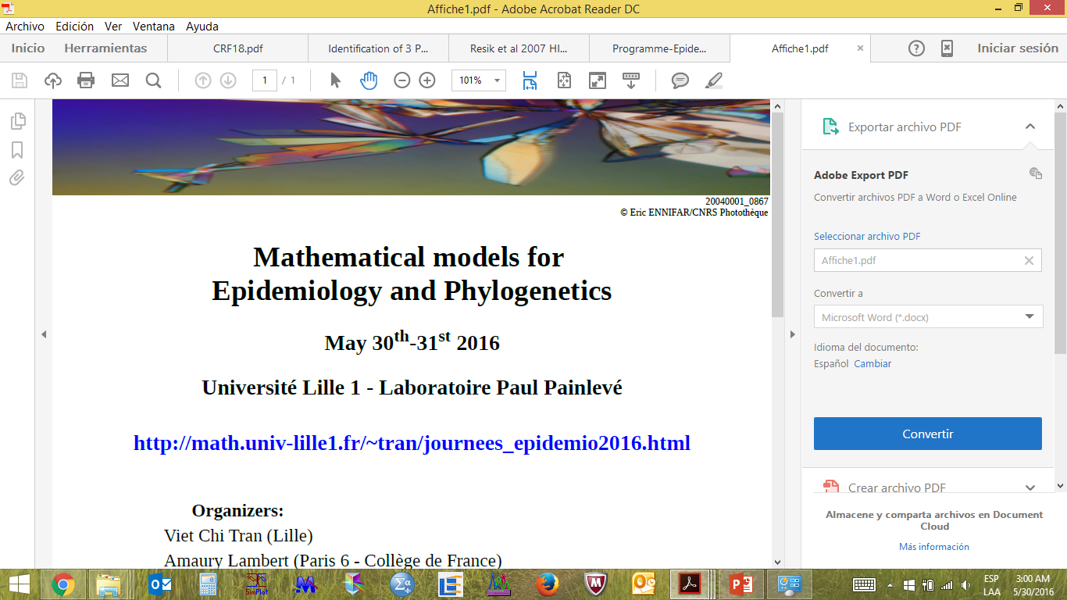


HIV-1 viral variants circulating in Cuba. Implications for disease progression.
Prof. Vivian Kourí, MD, PhD
Institute of Tropical Medicine Pedro Kourí, Havana, Cuba.
Notes:
Good afternoon. I would like to thanks to the organizers of this workshop, for giving me the opportunity to be here and share some of the researchs that we have done in collaboration with different colleagues.
I would like to say that my background is medical virologist thus I am ot very familiar with mathematics, I am just a modest users of some algorthims for phylogenetics analysis.

Slide 2
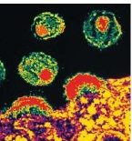
HIV is characterized by a high diversity
Two main mechanisms
Reverse Transcriptase enzyme
High error rate. Introduces substitutions, deletions and insertions
(3x10⁻⁵ bp per replication cycle)
Rapid turnover of HIV (t1/2 < 6 hours)
High level virus production (10¹⁰⁻¹¹/day)
Millions of people infected with HIV
Recombination mechanism
Due to strand-displacement, pausing RT at RNA breaks, and the presence of 2 genetically divergent RNA strains within 1 particle (7-30 events per replication cycle).
Notes:
For those persons not directly link to virology and HIV I would need to make a brief introduction.
HIV is characterized by a high diversity, and it mainly due to 2 mechanisms. The RT enzyme which has a high error rate, thus during reverse transcription it introduces subs, del, inser.
Rapid replication cycle, less than 6 hour
High level of virus production and million of people living with HIV all over the world.
The other mechanism is the recombination. In presence of 2 genetically divergent RNA strains within the cells, the RT jump from one strand to the other, conducing to the construction of a mosaic virus.

Slide 3
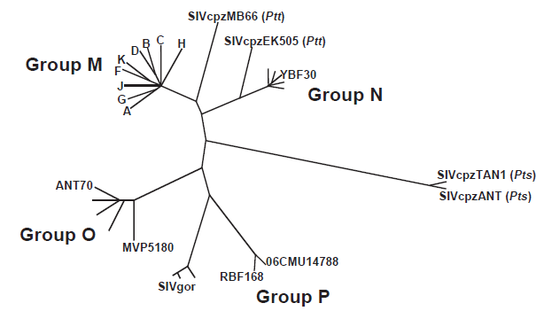
Genotypic Classification of HIV-1
9 HIV-1 subtypes
Phylogenetic relationships of HIV-1 groups M, N, O, and P with different simian immunodeficiency virus (SIVcpz and SIVgpr) isolates.
J Neuroimmune Pharmacol 2011;6:230–24

Slide 4
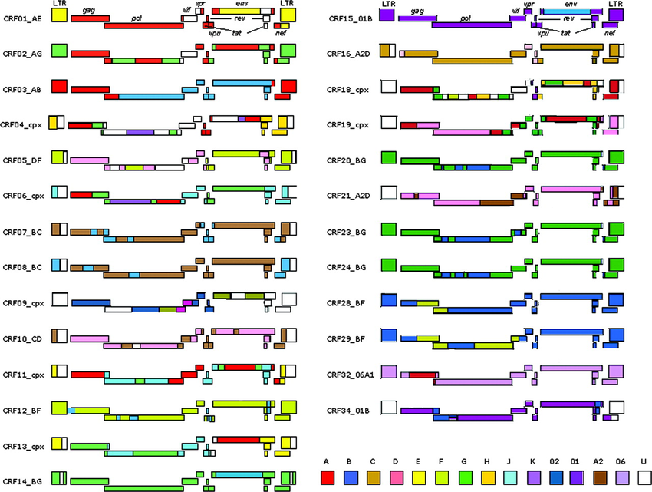
Circulant recombinant forms (CRFs)
78 CRFs and many URF
Notes:
Poner figuras de recombinantes

Slide 5
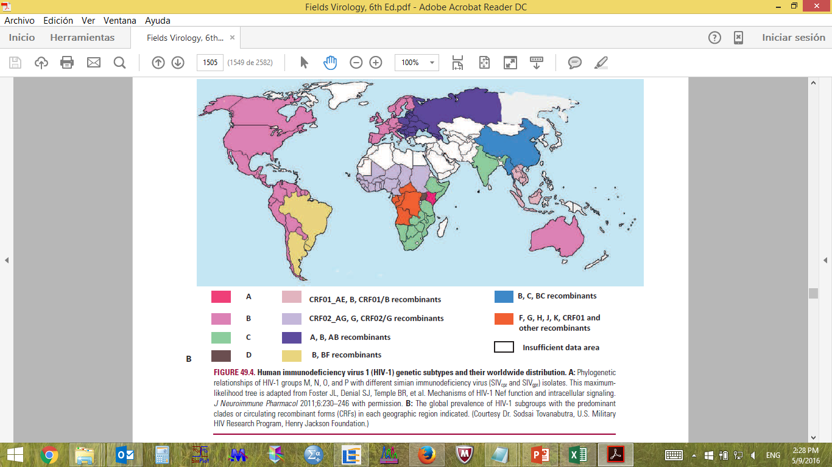
Global Genetic Distribution of HIV-1 variants

Slide 6
Cuban HIV Epidemic. Background
Cuba has low prevalence of HIV infection (around 24000 patients, 0,2%), >70% are currently receiving ARV treatment.
Major route of transmission: sexual (99%).
81% male sex, MSM more tan 70%.
First Cuban HIV-infected individual was diagnosed in 1986.
56 of the first HIV-patients were infected in Africa.
Presence of Cuban’s military and civilian during 1970s and 1980s in Angola, Ethiopia, DRC.

Slide 7
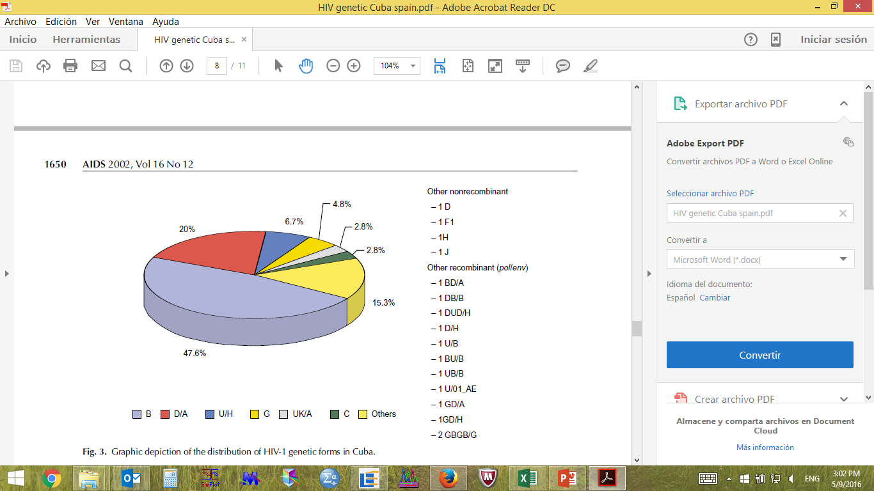
Cuban HIV Diversity
105 HIV-1-infected individuals from Cuba. Samples collected in 1999.
pol and env regions sequenced: 47.6% subtype B, many recombinants and undefined subtypes.
Cuevas MT et al. AIDS 2002, 16:1643–1653
Notes:
The HIV-1 epidemic in Cuba exhibits an extraordinarily high genetic diversity, in contrast to the rest of the Caribbean region. One of the first studies was performed in 2002 using samples from 1999

Slide 8
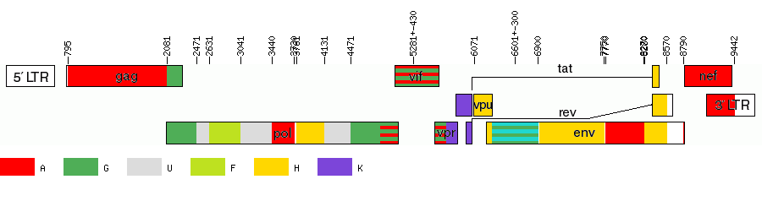
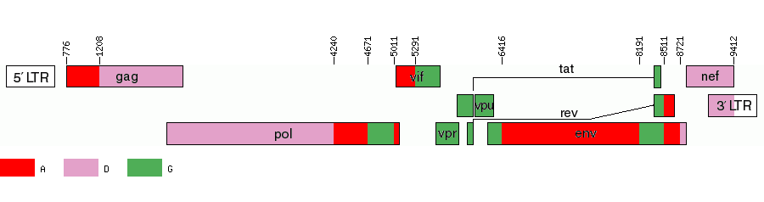
Cuban HIV Diversity
CRF18_cpx
Thomson et al., AIDS, 2005
2 Cuban individuals, diagnosed in 1995 and 1996, samples collected in 1999. Not epidemiologically related.
CRF19_cpx
Casado et al., J Acquir Immune Defic Syndr, 2005
4 Cuban individuals, diagnosed in 1997, samples collected in 1999. Not epidemiologically related.
Notes:
This result raised to the further study of some of these recombinant samples, and allowed defined 2 new CRFs

Slide 9
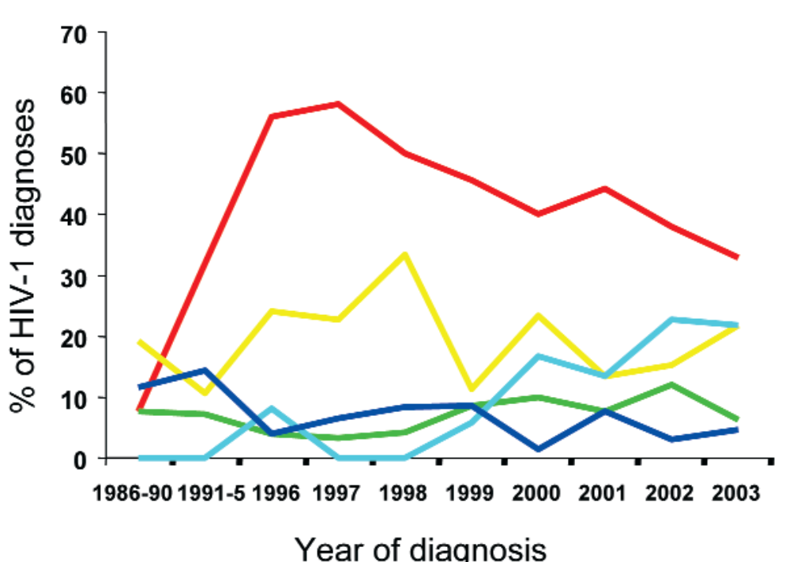
Cuban HIV Diversity
425 samples from Cuban HIV-1 infected individuals, samples taken in 2003
Subtype B, 41.2%; CRF19_cpx, 18.4%; BG recomb. 11.6%; CRF18_cpx, 7.1%; subtype C, 6.1%; subtype G, 3.8%; B/CRF18 2.6%; subtype H, 2.1%; B/CRF19 1.7%
and others, 5.4%.
Perez L et al., Aids Research and Human Retroviruses, 2006.
High HIV-1 diversity and frequent recombination in Cuba
Recent expansion of diverse related BG recombinant forms

Slide 10
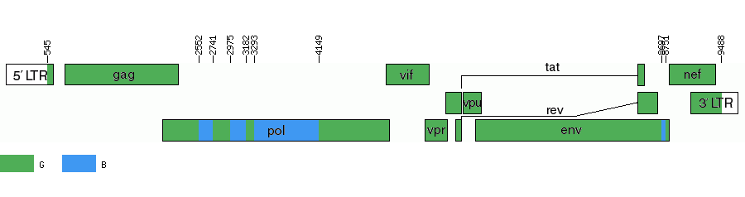
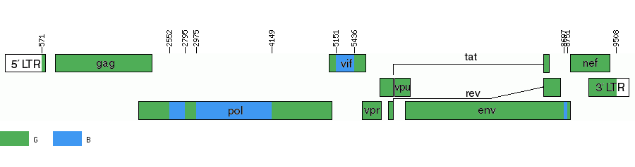

Cuban HIV Diversity
CRF20_BG
Sierra et al., J Acquir Immune Defic Syndr, 2007.
CRF23_BG
Sierra et al., J Acquir Immune Defic Syndr, 2007.
CRF24_BG
Sierra et al., J Acquir Immune Defic Syndr, 2007.
Notes:
The origin and expansion of BG CRFs in Cuba seem to
be recent. In samples collected in 2003, all individuals
harboring BG recombinants were diagnosed with HIV-1
infection in 2000 or later, except for 2 in 1997 and 1 in 1996.

Slide 11
Contact Tracing and Phylogenetic Analysis in Establishing HIV Type 1 Transmission Networks in Cuba
.
Two transmission networks established based on detailed interviews performed by specialists with special training in contact tracing when the subjects were diagnosed as HIV-1 seropositive.
Network 1 included 38 subjects
Network 2 included 89 subjects.
Both index cases infected in Africa.
HIV-1 region representing segments of gag and env were amplified and sequenced.
Phylogenetic trees were reconstructed using a maximum likelihood (ML) heuristic search in PAUP v4.0 b10
Resik et al., AIDS Res Hum Retrov 2007.

Slide 12
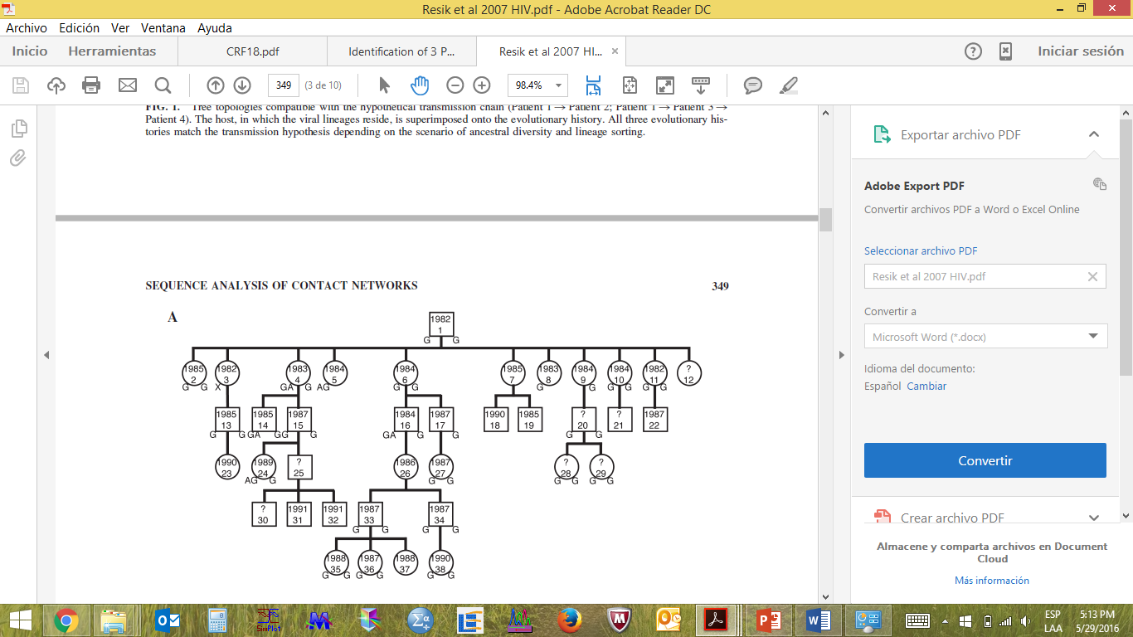
Epidemiological network 1
Subtype: G or A/G
Mainly HT transmission
Lower partner Exchange rate
Men: square, Women: circle.
Year of infection: inside the circle/square
Subtype: Letters outside the square/circle
Resik et al., AIDS Res Hum Retrov 2007.

Slide 13
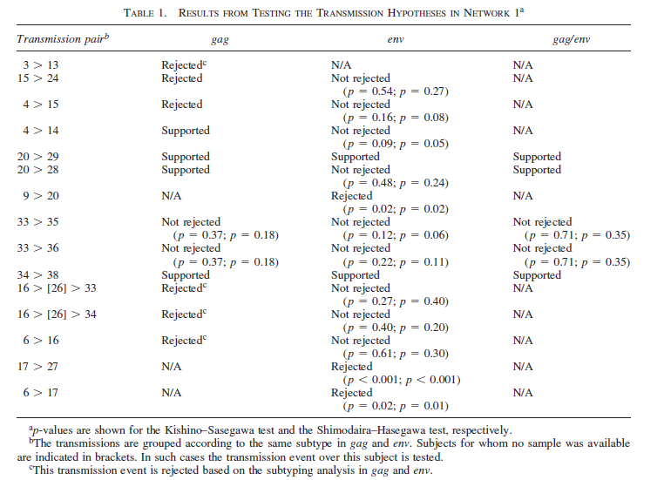
Resik et al., AIDS Res Hum Retrov 2007.

Slide 14
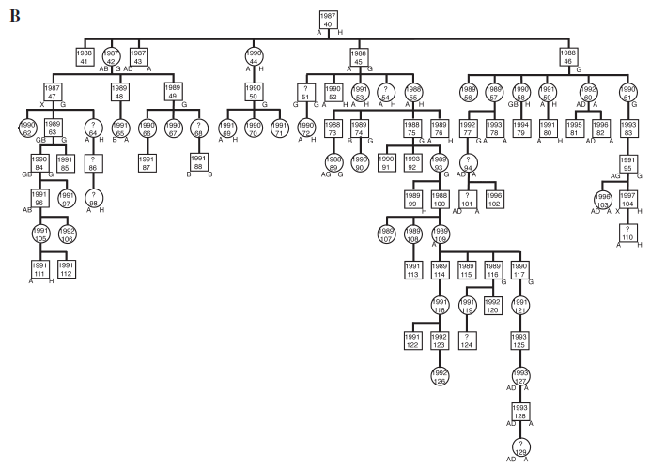
Epidemiological network 2
Subtype: different subtypes (CRFs?)
HT and MSM transmission
Higher partner Exchange rate
Men: square, Women: circle.
Year of infection: inside the circle/square
Subtype: Letters outside the square/circle
Resik et al., AIDS Res Hum Retrov 2007.

Slide 15
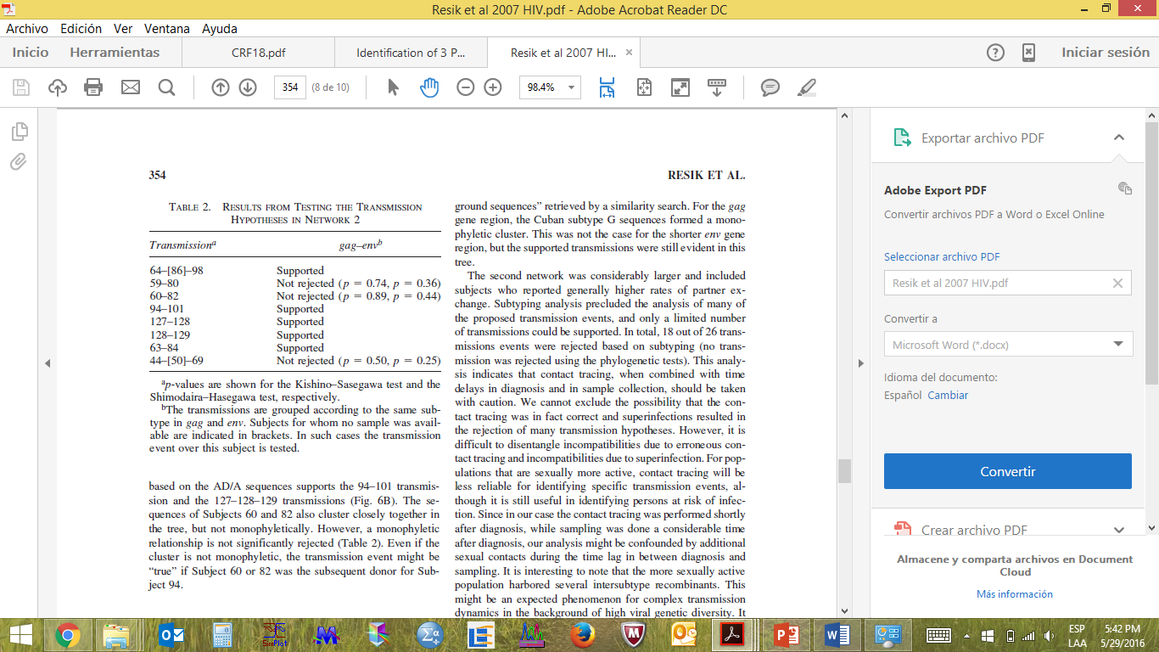
The results showed that contact tracing could be useful and reliable to identify “phylogenetically reconstructable transmission chains” only under certain conditions. For example, both sampling and contact tracing should preferably be performed close to the time of diagnosis and the time of transmission.
Resik et al., AIDS Res Hum Retrov 2007.

Slide 16
Methods
we set up an exploratory study in Cuba, to investigate the association of rapid progression with epidemiological, clinical, viral and immunological parameters, comparing three groups of patients.
95 patients HIV -1
Naive ARV
52 RP
Progression to AIDS <3 years from diagnosis,
Previous HIV negative test.
21 Non-AIDS
HIV + with <3 years from diagnosis, asymptomatics.
Previous HIV negative test.
22 Chronic AIDS
AIDS patient with
8-10 years since diagnosis.
Informed consent
September 2007–April 2011
VIRAL LOAD and CD4 at diagnosis and at sampling
V. Kouri et al. / EBioMedicine 2 (2015) 244–254
Notes:
We set up an exploratory study in Cuba to investigate the association of rapid progression with epidemiological, clinical, viral and immunological parameters, comparing three groups of patients. The first two groups were recruited prospectively who at sampling within 3 years after seroconversion either were already diagnosed with AIDS (AIDS-RP) or who were still AIDS-free (non-AIDS) and chronically infected HIV-1 patients with AIDS recruited retrospectively and sampled at AIDS diagnosis (chronic-AIDS).”
Read more at http://www.inquisitr.com/1848488/new-hiv-strain-crf-19-develops-into-aids-three-times-faster-than-normal-discovery-made-in-cuba/#oMj5yFe7DvyhE1AU.99

Slide 17

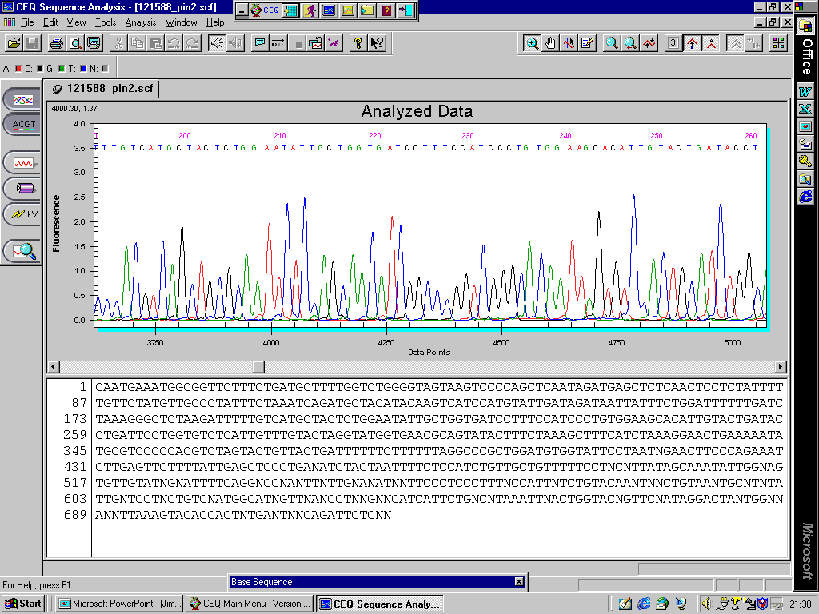
Methods
RNA extraction (plasma)
RT-PCR and sequence of pol (Prot/RT)
RT-PCR and sequence of env (C2-V3)
Subtype determination (Rega subtyping tool V3)
Subtype determination (COMET V2)
Phylogenetic tree Fast Tree (ML)
Transmission cluster analysis (cluster picker)
Prediction of resistance (CPR)
Prediction of co-receptor use (geno2pheno)
For fitness (genotypic fitness landscape)
Measurement of cytokines and chemokines in plasma: determined by FlowCytomix using fluorescent beads.
Host, immunological and viral predictors of RP were explored through data mining. Bayesian network (BN) was used to describe and visualize conditional dependencies between the multiple variables found significant in univariate analysis.
Kruskall-Wallis test, with Dunn’s multiple comparison test for quantitative variables.

Slide 18
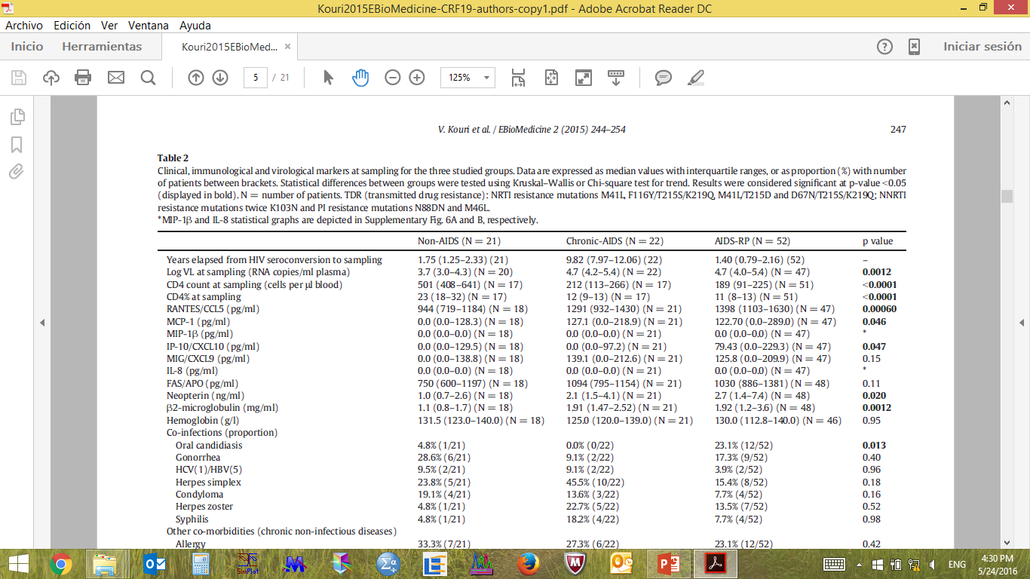
Clinical, immunological and virological markers at sampling for the three studied groups.
V. Kouri et al. / EBioMedicine 2 (2015) 244–254

Slide 19
VIRAL SUBTYPE
RP AIDS
CRF 19 and RP-AIDS p=0.0090
Recombinant A/D/G
3^{ro} in frequency in Cuba
Non-AIDS
Chronic AIDS
Subtype B and no RP p=0.034
V. Kouri et al. / EBioMedicine 2 (2015) 244–254
Notes:
Figure 1. CRF19_cpx is associated with rapid progression to AIDS. A) Prevalence of HIV subtypes distribution among the three studied groups: non-AIDS, AIDS-NP and AIDS-RP, classified according to the disease progression rates (see methods).

Slide 20
PHYLOGENETIC ANALYSIS OF CRF19_cpx.
C
CRF19_cpx, AIDS-RP
B reference sequences
Phylogenetic Tree of all CRF19_cpx samples.
CRF19-cpx-infected AIDS-RP (red), all CRF19_cpx sequences retrieved from Los Alamos database and all other available CRF19_cpx Cuban sequences at IPK (black), and B reference sequences (blue).
Our AIDS-RP patients were infected with divergent CRF19_cpx strains and had thus not transmitted a particular virulent variant among each other: none of them clustered in a transmission cluster.
Not epidemiologically related
V. Kouri et al. / EBioMedicine 2 (2015) 244–254

Slide 21
PHYLOGENETIC ANALYSIS. TRANSMISSION CLUSTERS
2 transmission clusters:
Subtype B: 2 Non AIDS, 1Chronic-AIDS, 1 RP
CRF20_BG: 2 Non AIDS y 2 RP
Phylogenetic analyses were performed on 2121 sequences for the analysis of all subtypes AIDS-RP (red), AIDS-NP (blue), non-AIDS (green) and reference sequences (magenta).
V. Kouri et al. / EBioMedicine 2 (2015) 244–254

Slide 22
Bayesian network model
AIDS-RP
100
Non-AIDS
41
40
37
B
52
46
51
Anal
Contact
Condom
Use
62
75
VL at Sampling
Neopterin
47
100
RANTES
69
Heterosexual
35
100
36
59
43
Oral
Candidiasis
45
MCP-1
B2
Microglobulin
66
42
51
CRF19_cpx
IP-10
Bayesian network model to predict either AIDS-RP or AIDS (AIDS-NP+AIDS-RP) patients.
Bayesian network analysis demonstrates a central role for CRF19_cpx in rapid progression to AIDS, showing direct influences between AIDS-RP, CRF19_cpx, Oral Candidiasis and RANTES (red circles). The stability of the dependency was assessed with a non-parametric bootstrap (100x replicates). All arcs with bootstrap over 35% are depicted in the network. An arc represents a direct dependency between the corresponding variables.
V. Kouri et al. / EBioMedicine 2 (2015) 244–254

Slide 23
Comparison of variables among HIV subtypes of all the three studied groups
V. Kouri et al. / EBioMedicine 2 (2015) 244–254

Slide 24
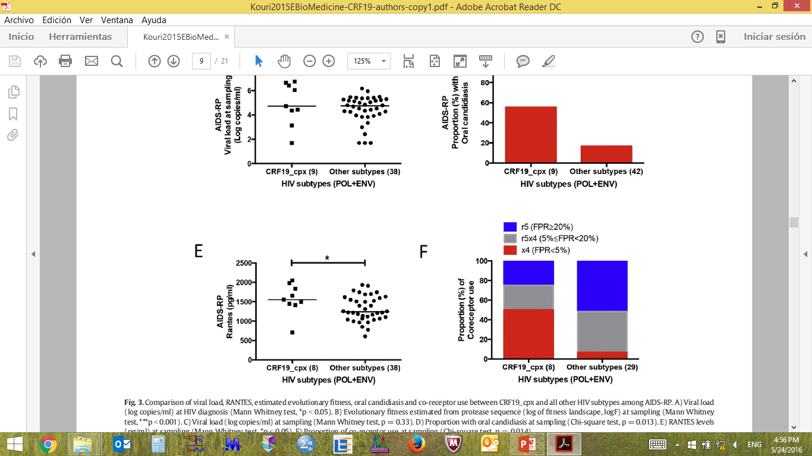
Comparison of variables between CRF19_cpx and all other HIV subtypes among AIDS-RP
V. Kouri et al. / EBioMedicine 2 (2015) 244–254

Slide 25
Conclusions
This study indicates that the genetic diversity of the Cuban HIV-1 epidemic is very high.
In recent years, the frequency of local recombinants is increasing while subtype B is decreasing.
We propose that an evolutionary very fit CRF19_cpx together with co-infections is linked to the increase of rapid progression to AIDS in newly infected patients in Cuba.
The robust and significant associations with a fitter protease, more circulating virus, higher immune-activation and CXCR4 co-receptor use suggest that CRF19_cpx may be a more pathogenic virus.

Slide 26
Acknowledgments
Anne-Mieke Vandamme, Kristel Van Laethem,
Ricardo Khouri,
Yoeri Schrooten,
Lore Vinken,
Jurgen Vercauteren,
Andrea-Clemencia Pineda-Peña,
Kristof Theys,
Sarah Megens,
Michel Moutschen,
Nico Pfeifer,
Johan Van Weyenbergh.
Lissette Pérez,
Yoan Alemán,
Jorge Pérez,
Carlos Fonseca,
Lilia M Ortega,
Jorge Campos,
Celia M Limia,
Yudira Soto.

