Slide 1
Inferring transmission patterns in animal disease systems using phylogenetics
(short version)
Check here for links to papers when published
www.roslin.ed.ac.uk/sam-lycett/
Dr Samantha Lycett
Infection & Immunity Division, Roslin Institute, University of Edinburgh
31 May 2016

Slide 2
Outline
Trees with traits
Resolving transmission Patterns
BVD and movement data
Avian influenza and correlated traits

Slide 3
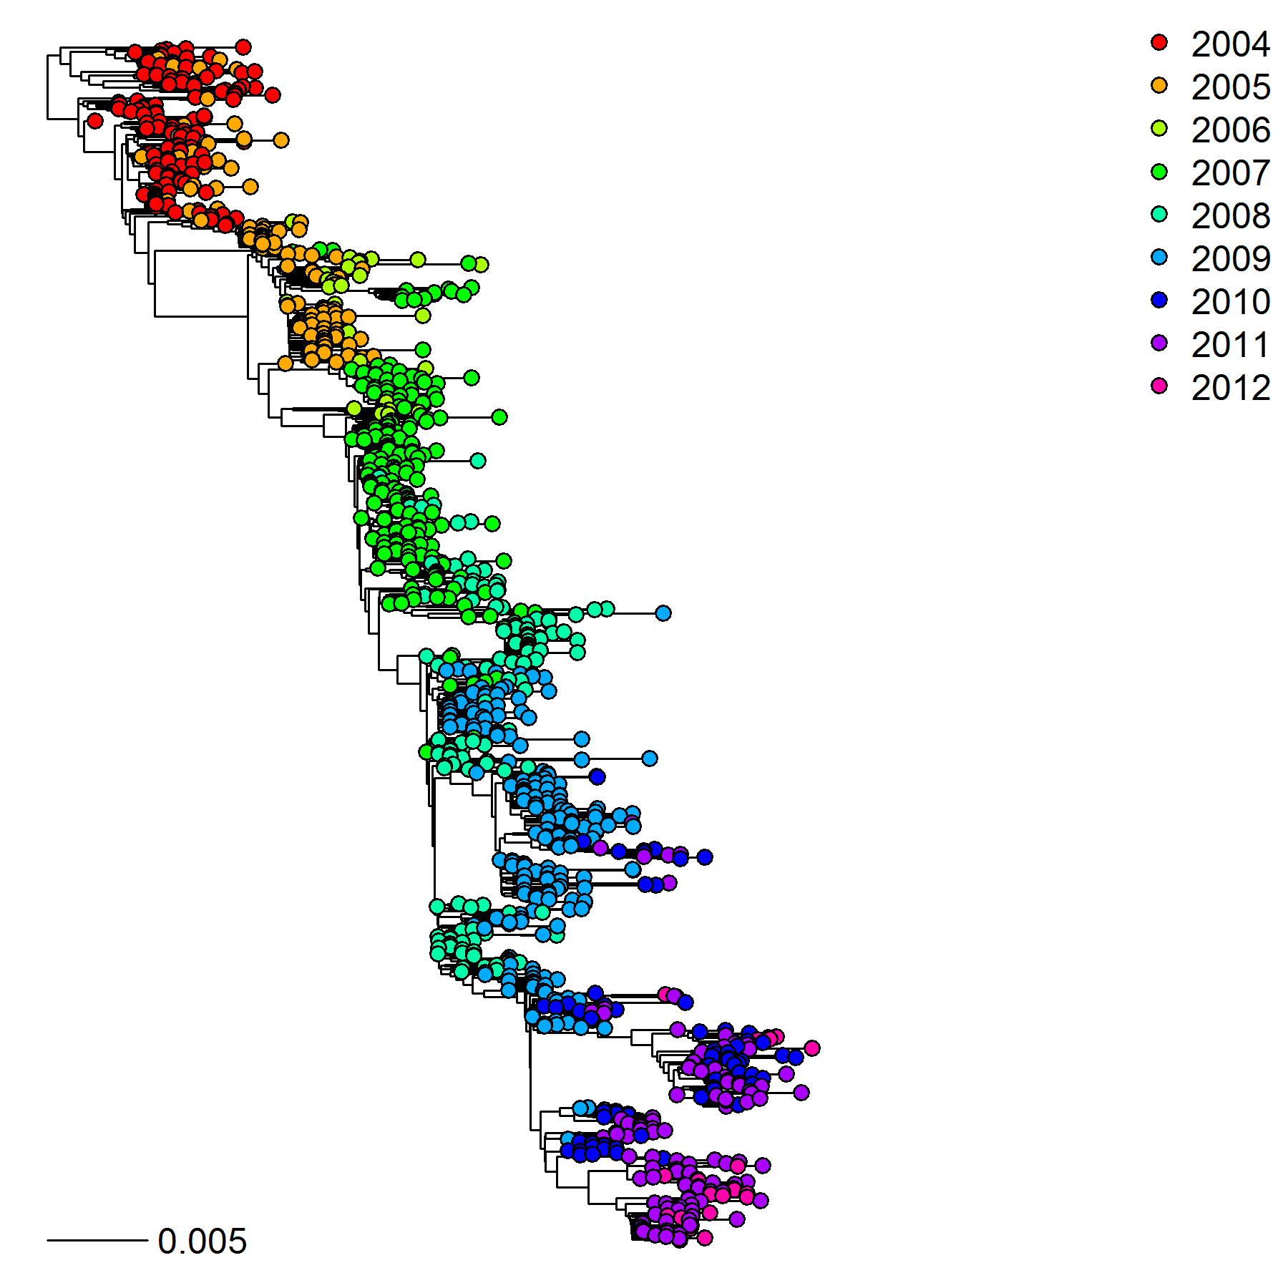
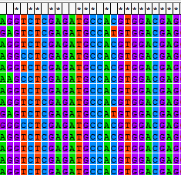
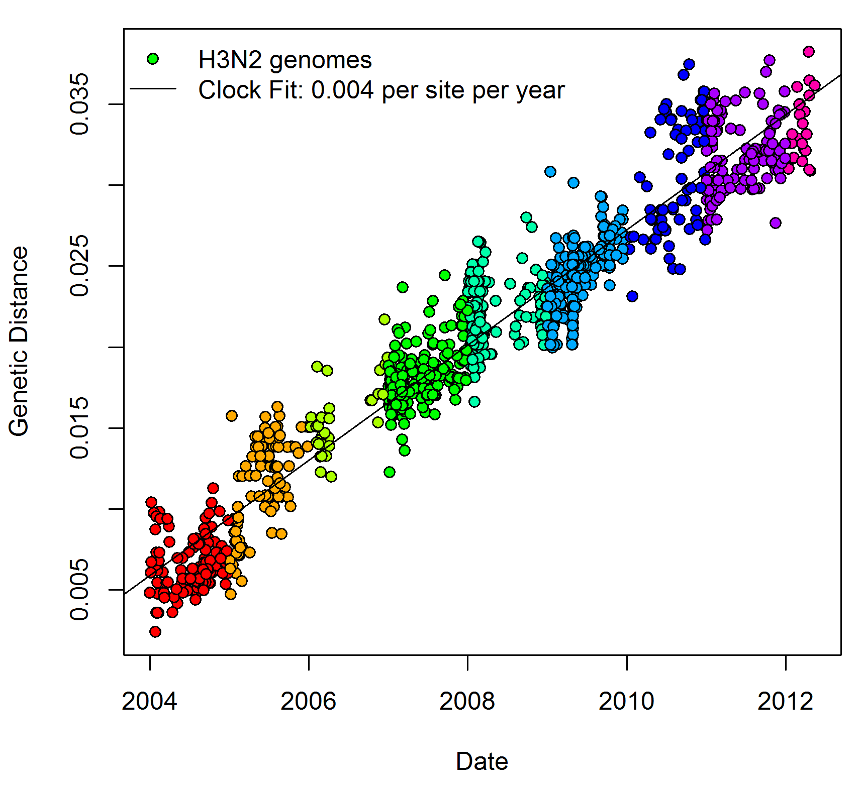
Pathogen Sequence Data
Pathogen sequence data provides richer information than strain type
Sequences accumulate mutations over time
Sequences, one per row
Tree of Human Influenza
Genetic Distance from Root
Genetic Distance
2004
2012
Date
Mutations
Conversed

Slide 4
Evolutionary Rates
 | RNA Viruses | DNA Viruses | Bacteria
Replication & Evolution | Fast and error prone | Slower, more conserved | Very slow
Genome size | 8-14kb | 20-200kb | 4Mb
Mutations per year | 10-100 | 1-20 | 0-1
Classical Swine Fever
Bovine Viral Diarrhoea
Foot-and-Mouth
African Swine Fever
Bovine Tb
Segmented ssRNA
Segmented dsRNA
Avian influenza
Schmallenberg
Blue Tongue
African Horse Sickness

Slide 5
Trees, Traits and Phylogeography

Slide 6
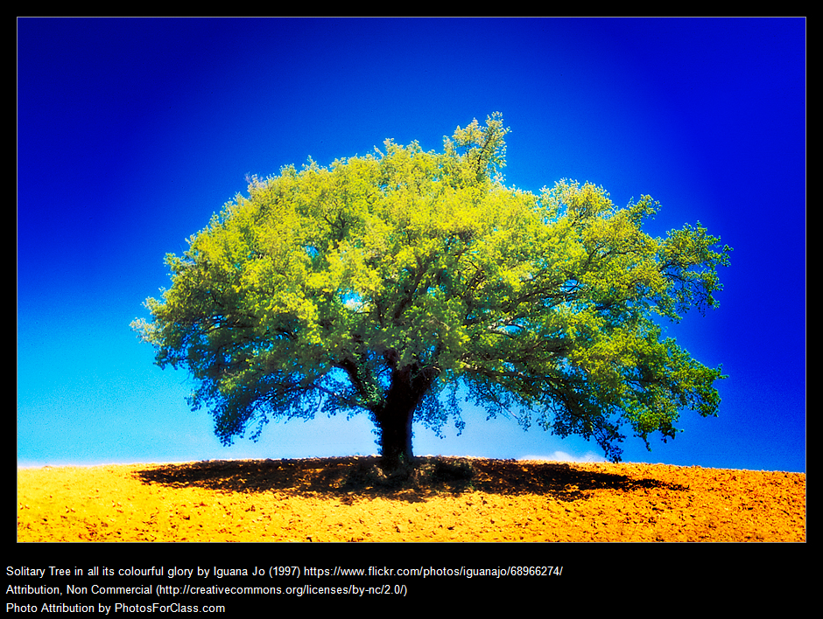
Trees
A “plain” tree
leaves (tips)
branches
root

Slide 7
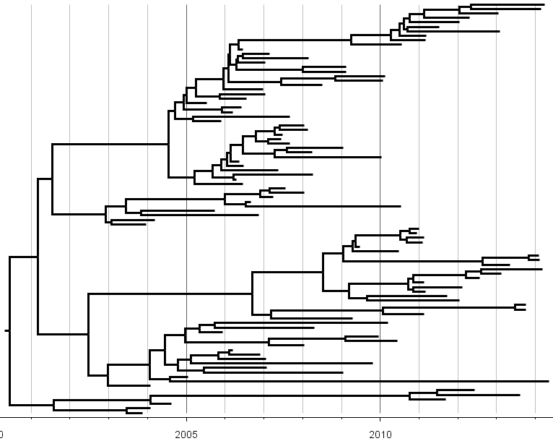
Trees
A “plain” tree – timescale by molecular clock
branches
root
leaves (tips)
Time to most recent common ancestor
(root age)

Slide 8
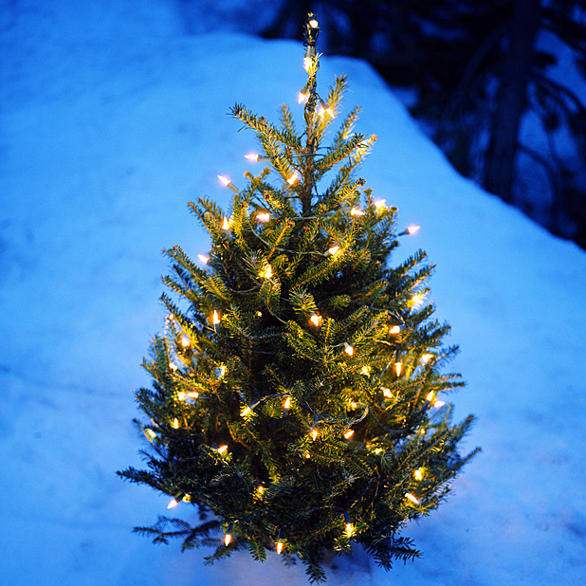
Trees and Traits
Add traits to the tips;
Infer ancestral states
(decorated tree)

Slide 9
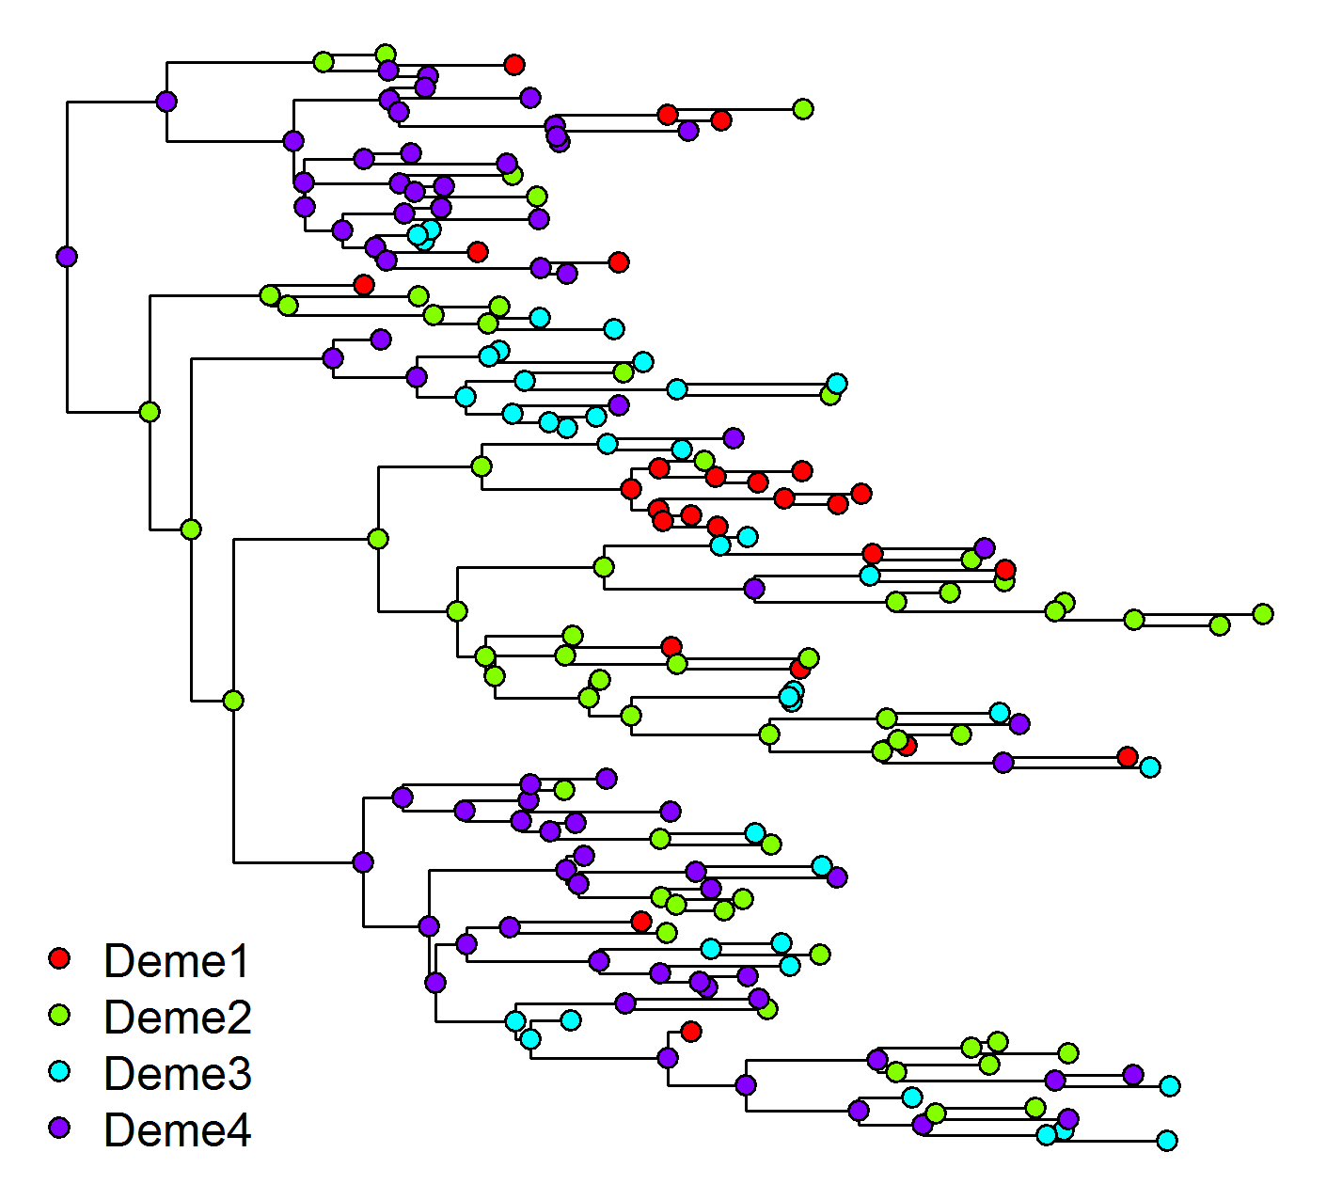

Discrete Trait Models
Tree with Location Traits
Transition Rate Matrix (M)
A
C
D
Probability of Ancestral state (x’), given branch length t and child state x:
B
Add locations to phylogenetic tree
Estimate transition rates between locations along branches
Transmission pattern represented by rate matrix
Notes:
Many sequences from each location; some clustered on tree, some not
Infer rate of transition between locations along branches of tree
Symmetric or Asymmetric “Discrete traits model”
Also infer most likely state for ancestors

Slide 10
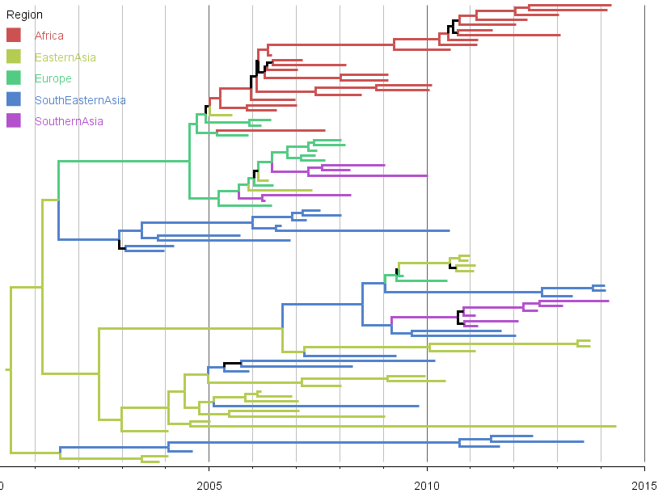
Trees and Traits
Add traits to the tips; infer ancestral states
Epidemic started in Eastern Asia

Slide 11
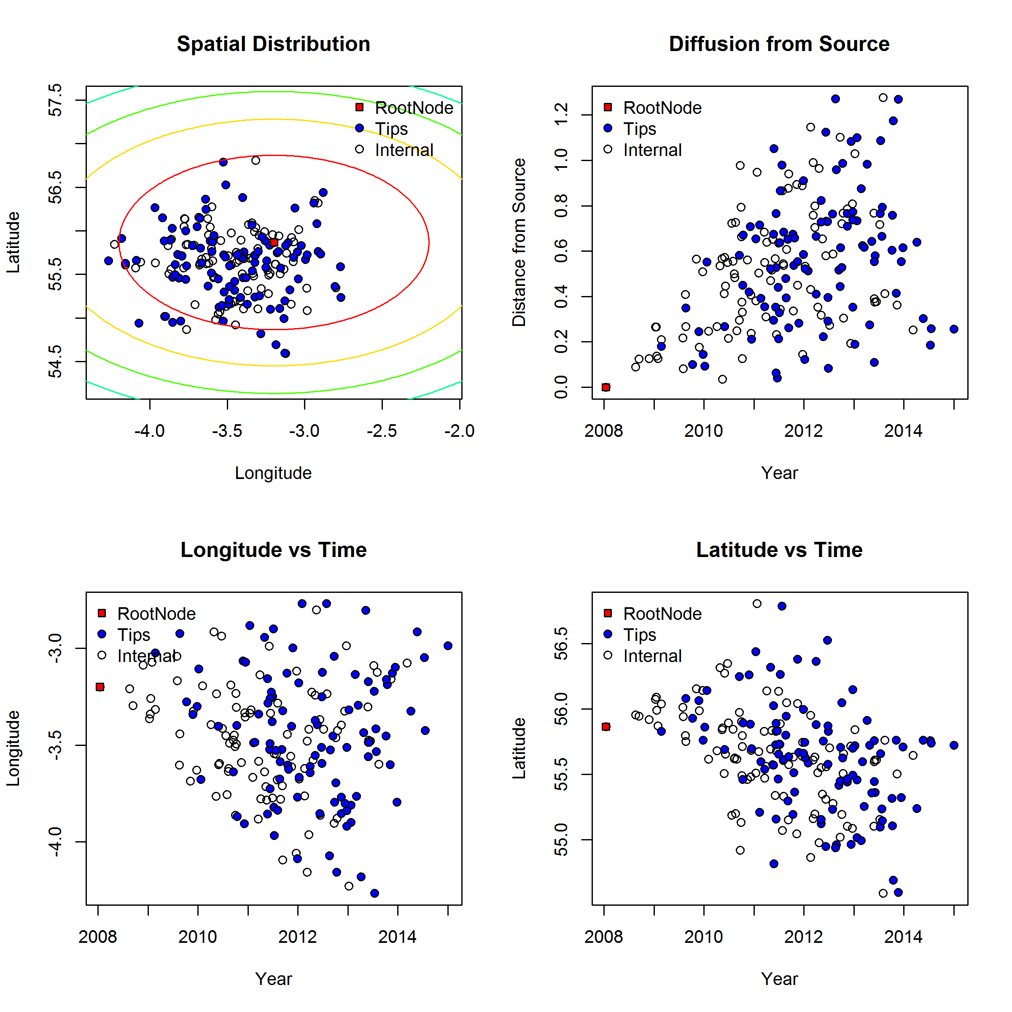
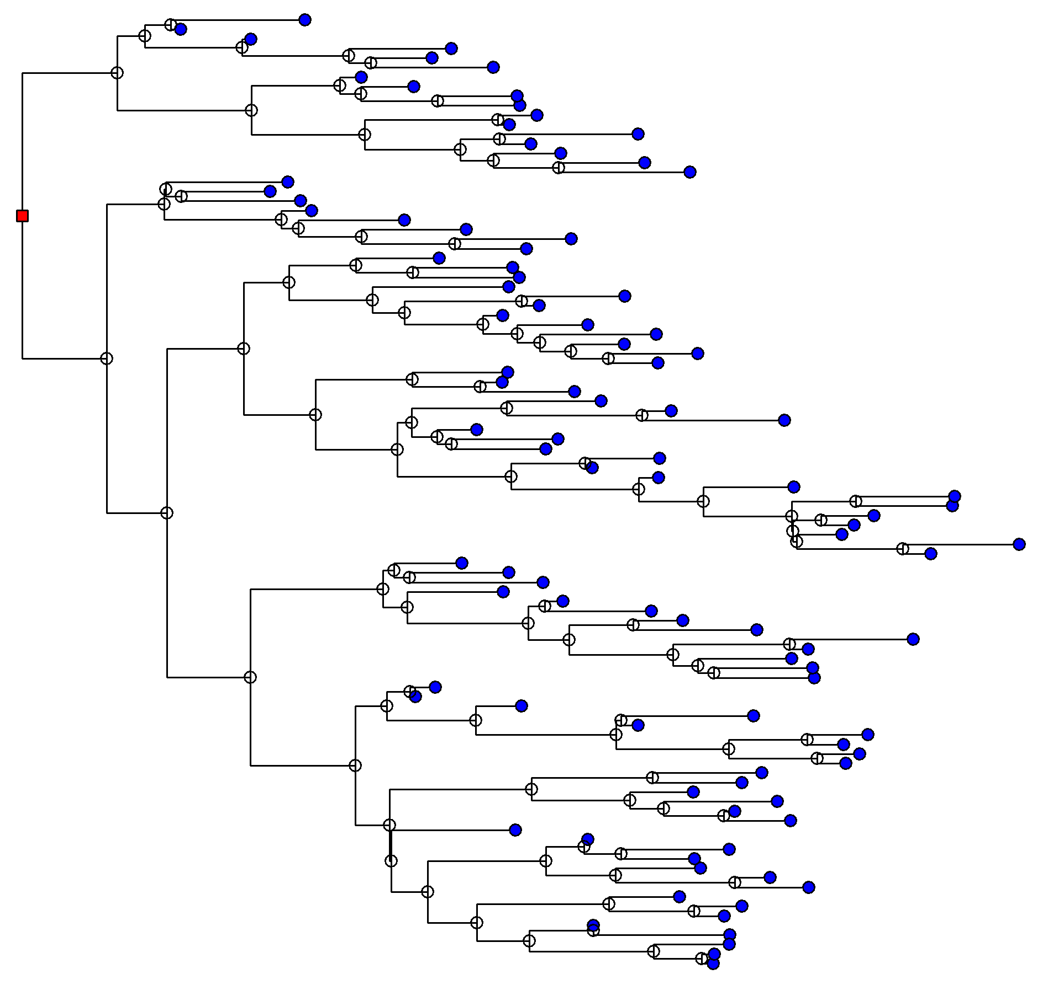
Spatial Diffusion
Model the spatial coordinates as continuous traits on the tree
Viral lineages “diffuse” from a point source
  Distance of child node is expected diffusion distance from parent node assuming time t has elapsed
  Uses Brownian motion (random walk) diffusion model and extensions

Slide 12
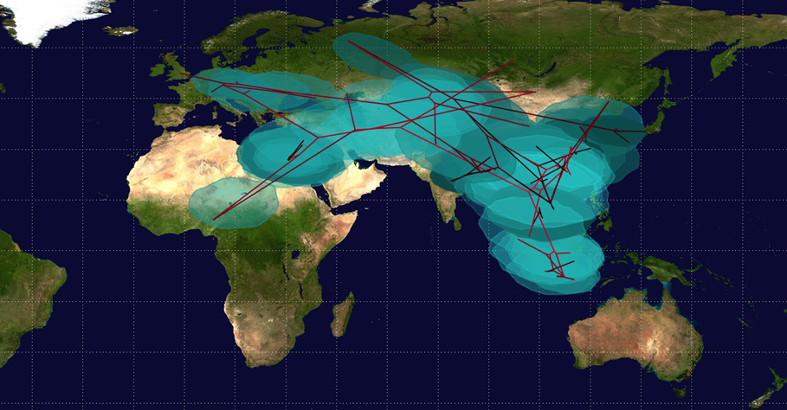
Spatial Reconstruction
Summary Tree mapped to Latitude-Longitude (SPREAD)
Circles represent uncertainty

Slide 13
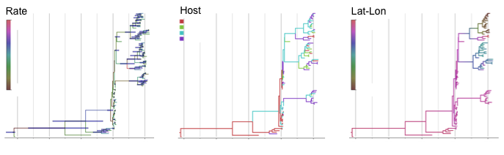
Current Methods Menu (BEAST)
Time scaled trees
With Discrete trait
With Continuous Trait
A/symmetric
BSSVS
GLM
Diffusions in space
Relaxed diffusions
Warped space
Substitution models
Clock models
Population models
Tree Priors
Posterior set of many likely trees (MCMC)
Structured coalescents

Slide 14
Approximations
Structured coalescent
  “Correct” if assume structured population
  Too slow
Joint inference
  Posterior informed by genetic data and spatial data
  If no genetic variation then tree would be clusters of locations
Traits mapped to trees
  Create trees from genetic data only
  OK if a lot of genetic variation (e.g. influenza)
  Very fast

Slide 15
Resolving Transmission Patterns
How much sequence variation is needed to detect a transmission pattern ?

Slide 16
Simulate Trees
From
DiscreteSpatialPhyloSimulator (DSPS) to simulate infection over structured population
Individual based model, individuals are farms
6 regions (random mixing within demes)
  500 farms per deme
  Each farm is SIR; beta = 0.1, gamma = 0.05
  Infection between demes = 0.1
  Demes connect in LINE or STAR network
LINE
To
A
B
C
D
E
F
STAR
From
F
To
E
B
A
D
C
Code available – currently tidying & validating…
https://github.com/hxnx-sam/DiscreteSpatialPhyloSimulator

Slide 17
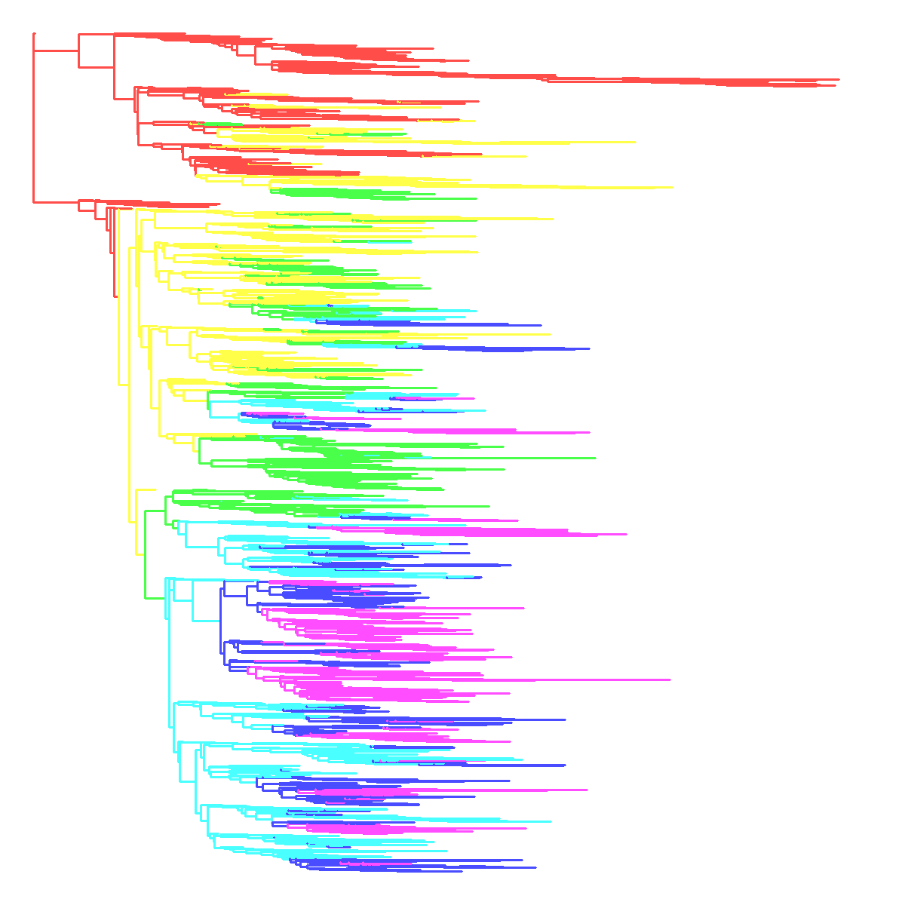
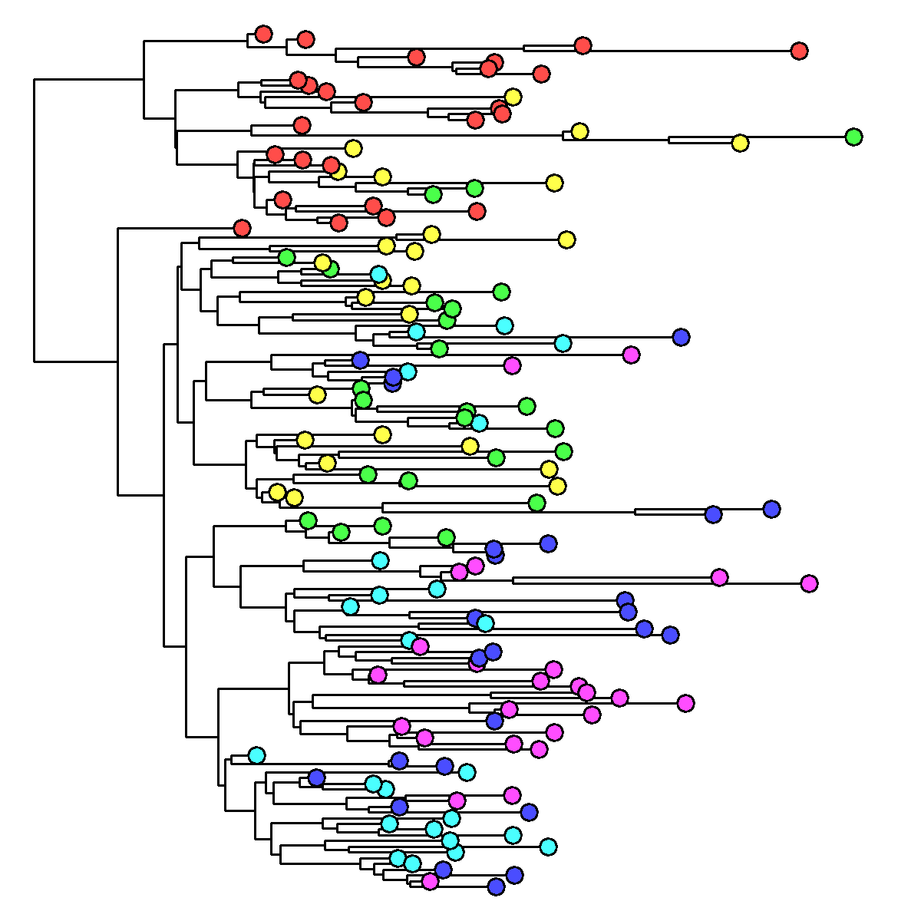
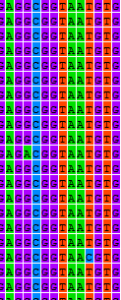
Simulate Sequences
Each event is recorded; output true transmission tree and phylogenetic tree
Rescale and subsample phylogenetic trees so that samples span 3 years
Simulate sequences down tree
  Evolution model based on analysis of real sequences (e.g. BVD, Flu)
  Overall clock rate from 0.5 – 5 x 10-3 substitutions per site per year
  Simulate between 500 and 5000 nucleotide sequence lengths
A
G
C
T
Substitution Model
& Clock Rate
Full Tree
(2370 tips)
Rescaled & subsampled tree
(25 per deme = 150 tips)
150 Sequences

Slide 18
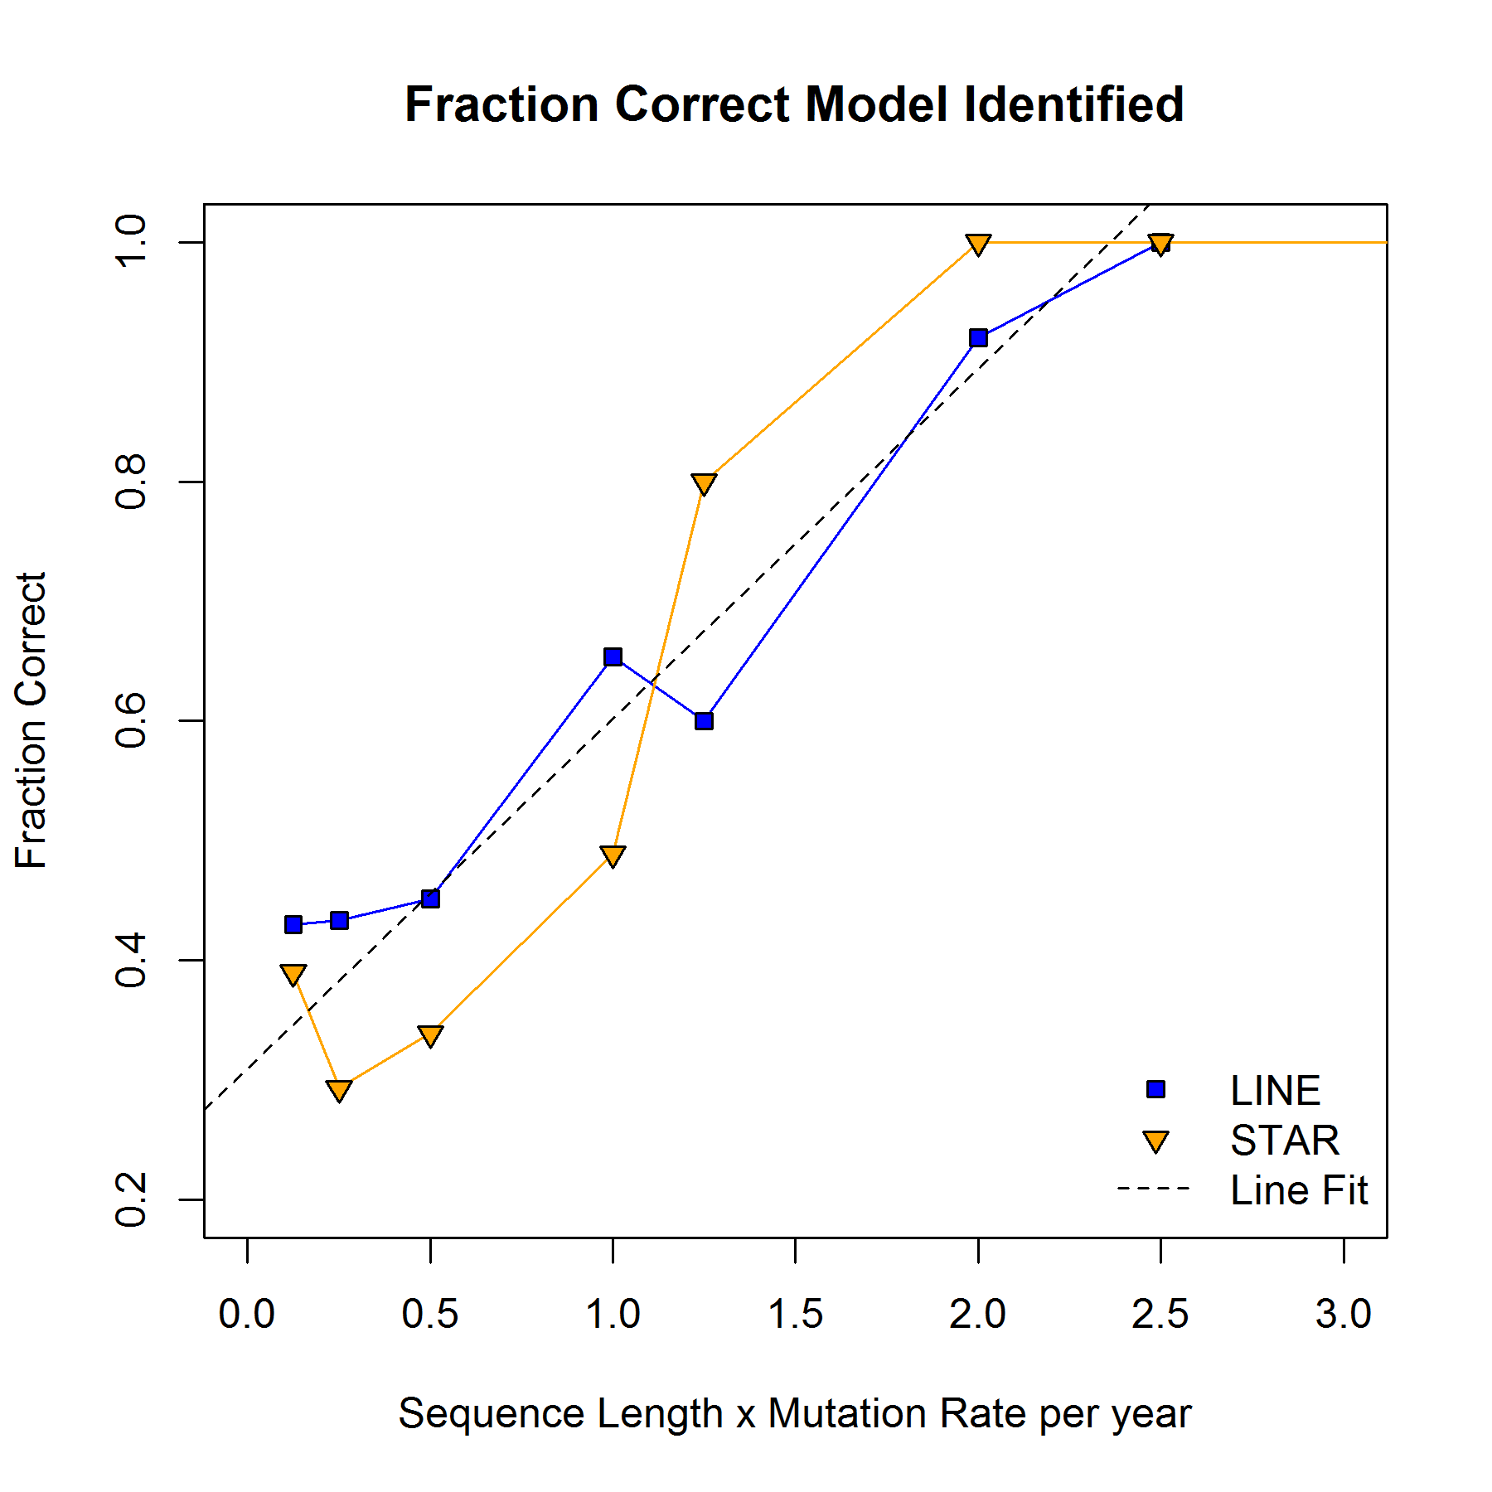
Finding the correct pattern
Reconstruct trees from simulated sequences using Neighbour Joining
Calculate likelihood of line, reverse line, star, reverse star models upon reconstructed trees
Fraction of simulations where correct transmission pattern found is a function of sequence length x mutation rate
Fraction Correct Model Identified over many simulations
Fraction Correct
LINE
STAR
Sequence Length x Mutation Rate Per Year
2 mutations per year => 90% correct
(note: also can use ace in R package ape, or fitDiscrete in R package geiger to do ML model fitting to trees)
Notes:
Fraction of trees where correct transmission pattern identified
function of sequence length x mutation rate (expected number of mutations per year).

Slide 19
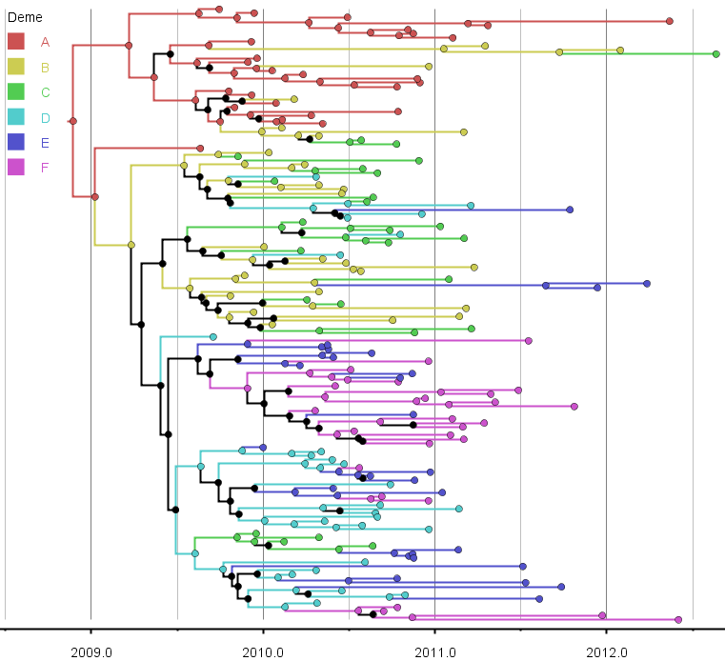
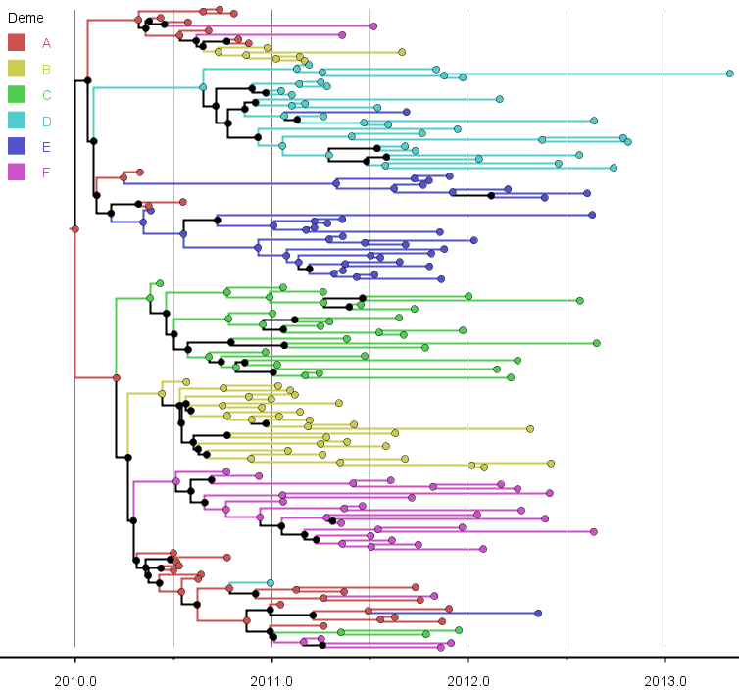
Phylodynamics using BEAST
Infer trees and transition rate matrix with BEAST
Use Line and Star scenarios with differing sequence lengths and mutation rates (slow & short, moderate, fast & long)
LINE
STAR

Slide 20
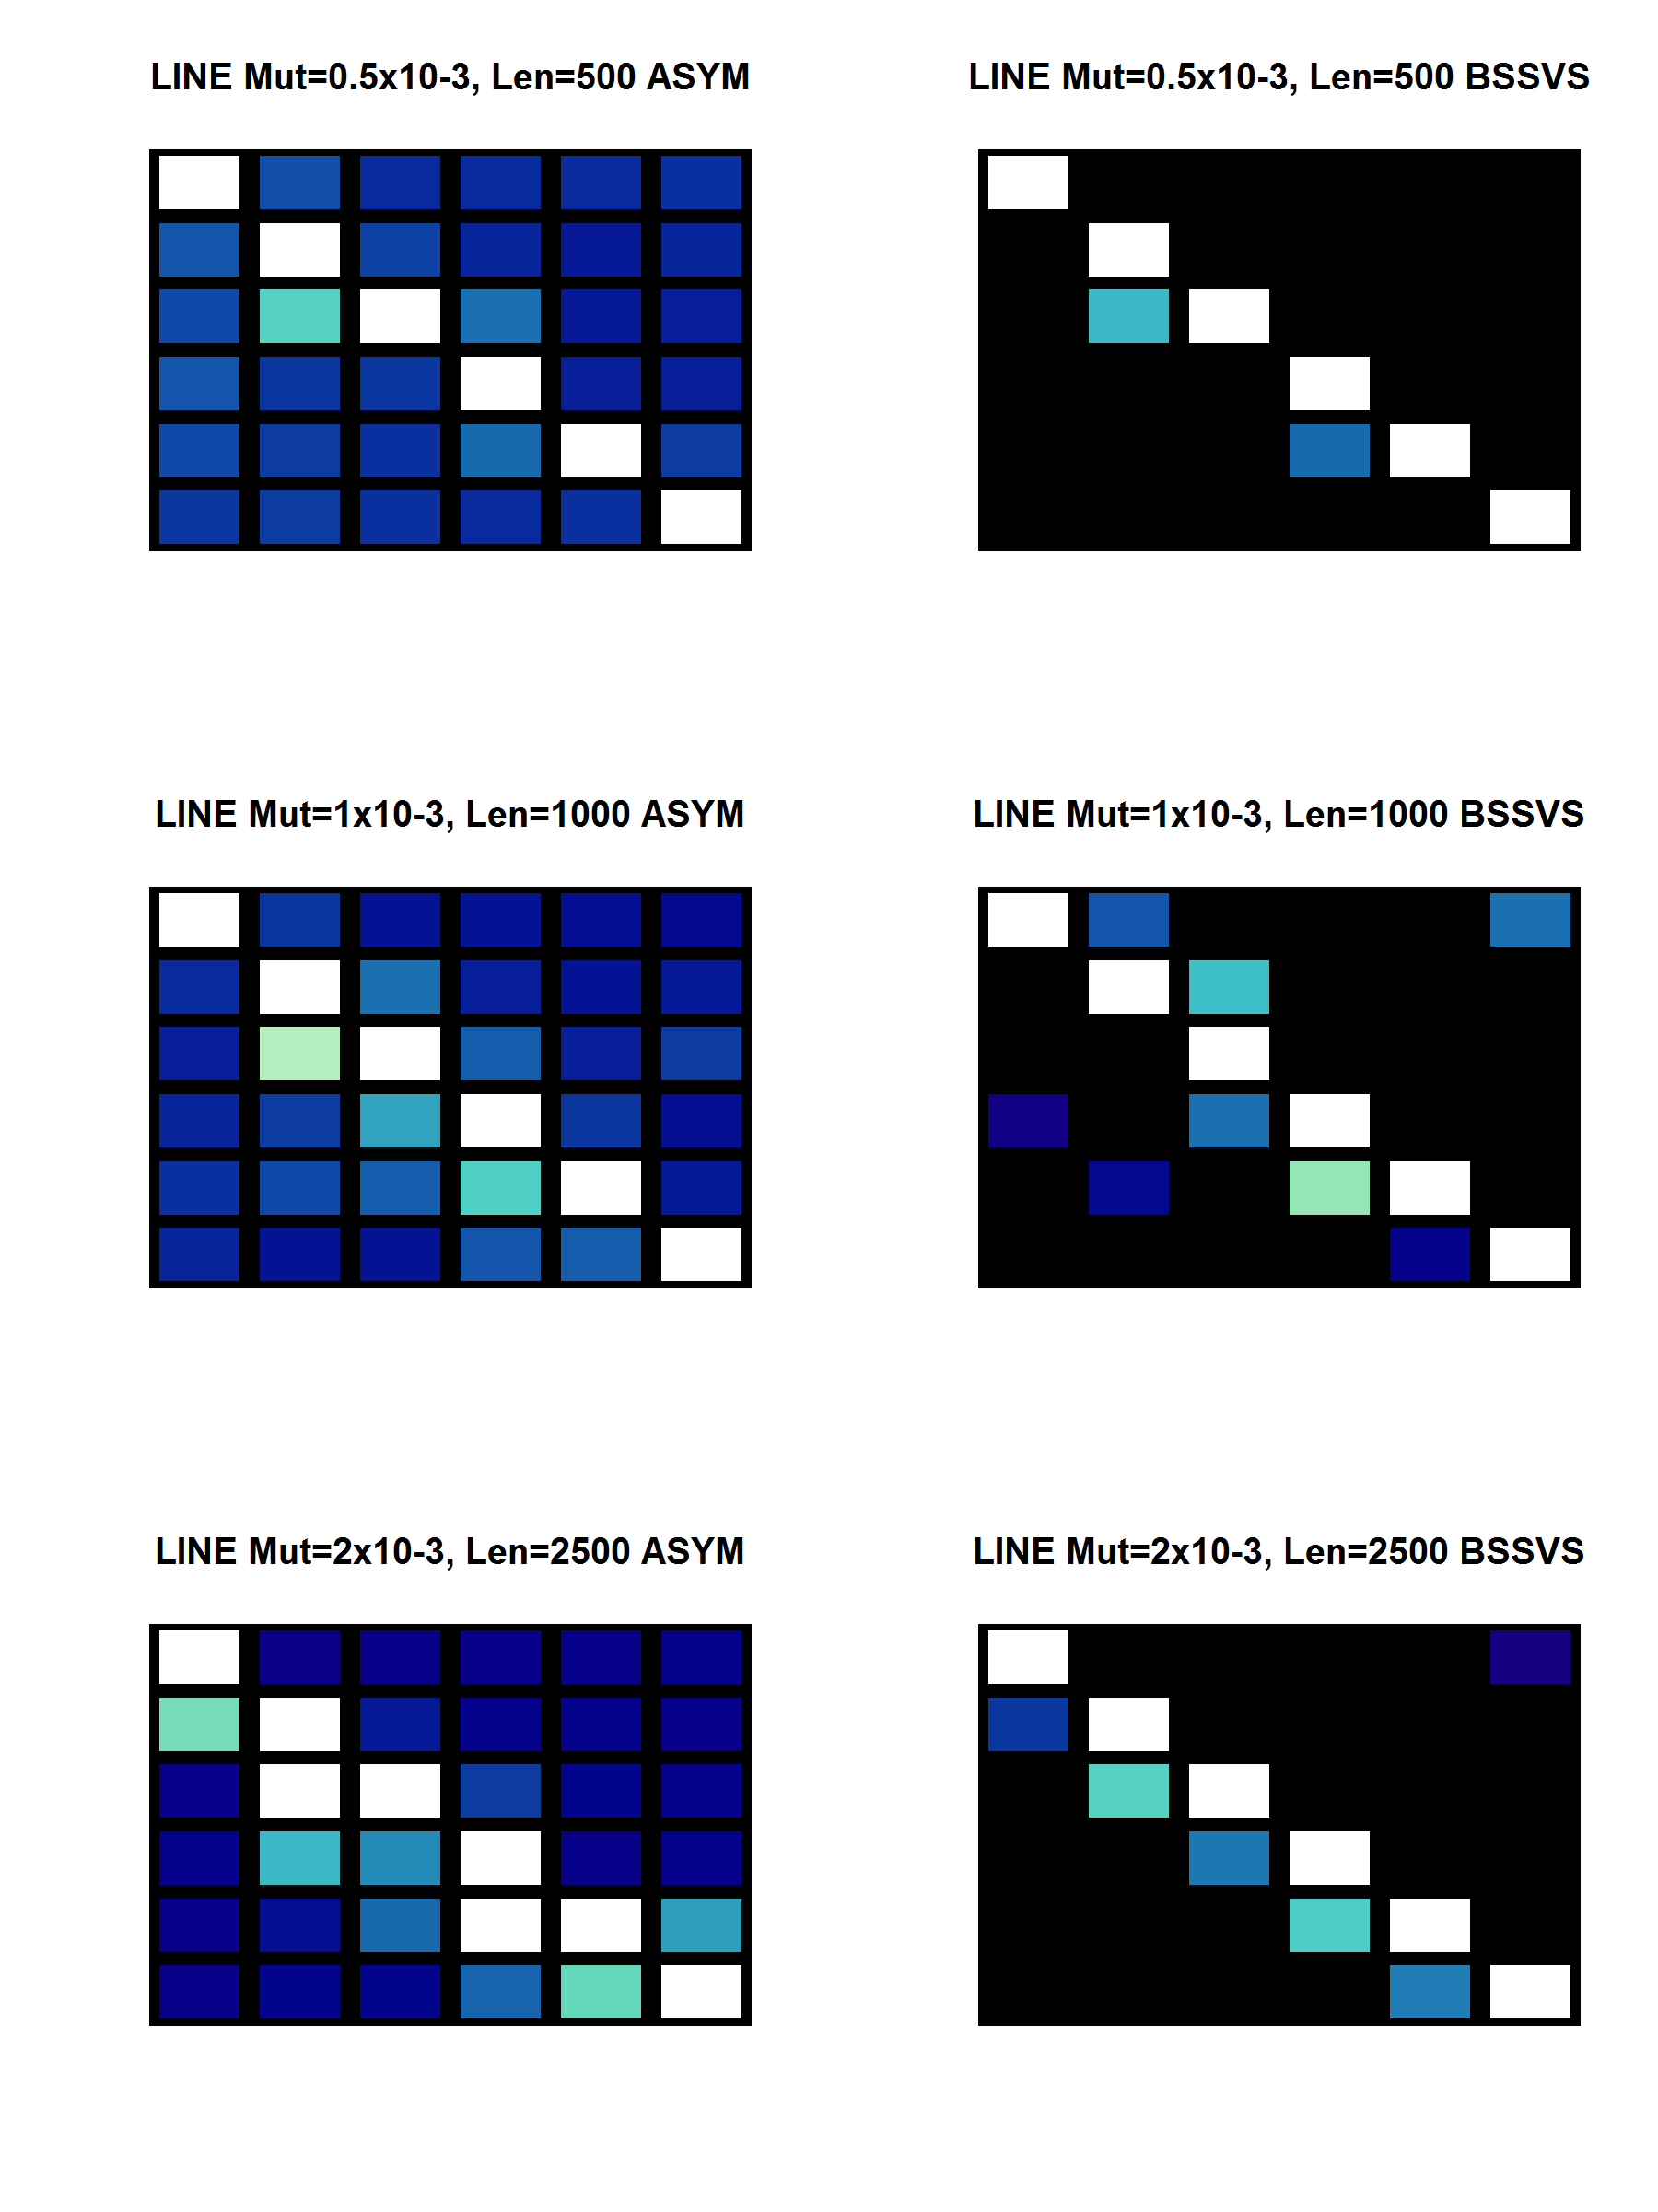
Detecting Line Population Structure
Full Rate Matrix
Significant Rates
(i) Short and slow
Mut. Rate = 0.5x10-3
Length = 500
LINE
Population
Structure
(ii) Moderate
Mut. Rate = 1x10-3
Length = 1000
BVD
(single region)
(iii) Long and fast
Mut. Rate = 2x10-3
Length = 2500
Flu
(HA)

Slide 21
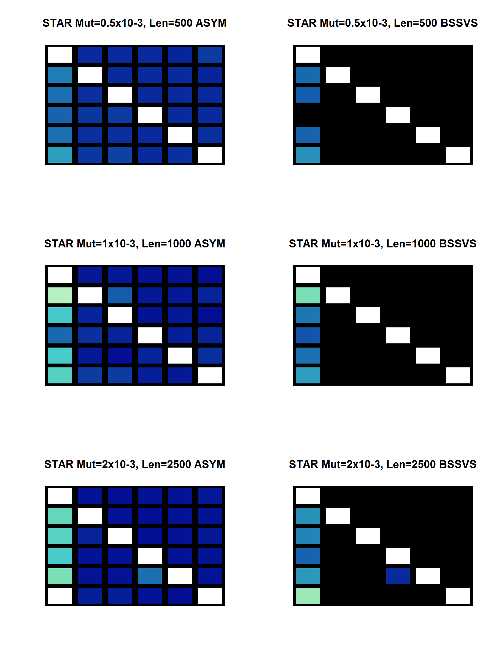
Detecting Star Population Structure
Full Rate Matrix
Significant Rates
(i) Short and slow
Mut. Rate = 0.5x10-3
Length = 500
STAR
Population
Structure
(ii) Moderate
Mut. Rate = 1x10-3
Length = 1000
BVD
(single region)
(iii) Long and fast
Mut. Rate = 2x10-3
Length = 2500
Flu
(HA)

Slide 22
Example : Bovine Viral Diahorrea and use of movement network data
Paper 1: General description of BVD data is in prep
Paper 2: BVD + Networks + GLM to be written later in 2016

Slide 23
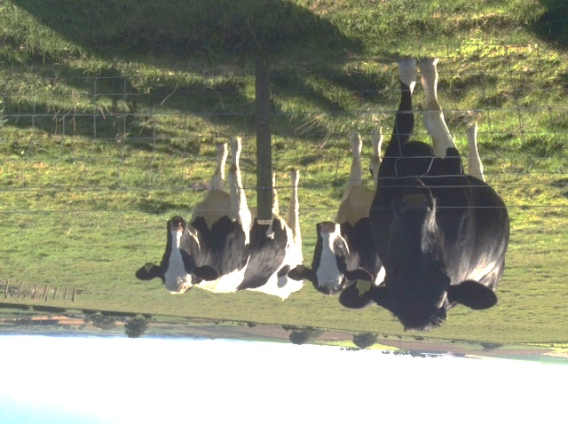
Bovine Viral Diarrhoea
BVD is endemic in Scotland and the rest of GB
Calves may become persistently infected in utero
Movement of infected animals spreads the disease
BVD Eradication Programme in Scotland
Can we use sequencing technology to help uncover the routes and risks of BVD transmission ?

Slide 24

Inferring Transmission Patterns
Sequences accumulate mutations over time
In principle could be used to infer who infected whom …
  If fast mutation rate & long sequences
  If dense sampling
BVD sequences
  Find closely related isolates
  Infer viral flows between locations e.g. regions or counties
Approx 500 samples of BVDV Type 1a at time of this analysis
  Mostly Scotland, but some England (not reflect prevalence)
  Collected in 2013-2014 but efforts ongoing

Slide 25
Spatially Distributed Clusters
Connect samples with unique post code, date and sequence if genetic distance = 0
Observe some clusters which span England and Scotland
Create BEAST trees on full data set, and mark the clustered sequences on the trees
Calculate the TMRCA of the clusters
Find that spatially distributed clusters have origin time of ~ 1-3 years

Slide 26
Transmission Patterns
EPIC Type 1A sequences split into 14 regions
Significant rates between regions calculated with BEAST discrete trait BSSVS
Plot regions and arrows between regions to show the significant links
Long range links between England + Wales and Scotland
Also, “local” exchange across the border
(note these are across the entire tree)

Slide 27
Can we find factors that influence the transmission pattern ?

Slide 28
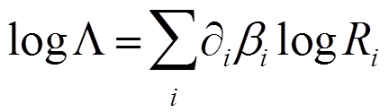
Integrating Network Data
Are the transmission patterns due to known animal movements ?
Or is there something else ?
Use a Generalised Linear Model to parameterise the rates, available in BEAST 1.8
Transition Rate Matrix
For i=1 to n predictors
Predictor Rate Matrix
(for each MCMC step, propose βi’s and δi’s)
Indicator variable, delta dirac (0 or 1)
Coefficient of predictor matrix
Now estimate the δ and β instead of each rate matrix element

Slide 29
Cattle Tracing System Network
Every cow tracked in UK
CTS records birth, death, movements, on day at farm locations
For this GLM study use predictors:
  Network Movements : average by region 2008-2013 (try asymmetric and symmetric-ised versions)
  Distance (average between farms in regions)
  Births per region (to reflect the PI aspect of the disease)
  Gravity model: source size x recipient size / distance ^ 2

Slide 30
GLM Results
Different combinations of predictors used (4 sets)
Plot inclusion probability and coefficient for each predictor
Births in source region important
Distance > Symmetric Network, but all Networks > Gravity

Slide 31
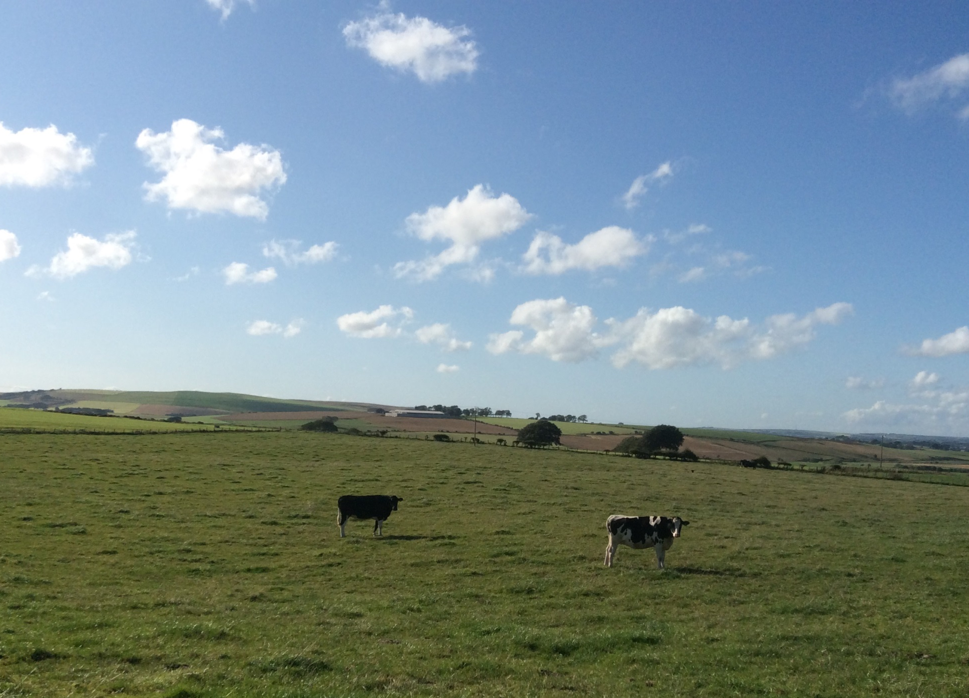
BVD Summary
Detected local and long range linkages
Movement networks (partially) explain BVD transmission patterns
Correlation of phylogenetics with movements of PIs ?
“Integrated Phylodynamics”: combine data sources, especially sequences and movements

Slide 32
Example:
Avian Influenza and Correlated Traits
Paper: currently in review

Slide 33
Influenza Viruses
8 RNA Segments coding for 10+ proteins
Virus subtype defined by surface proteins:
  Hemagglutinin (HA) and
  Neuraminidase (NA)
Reassortments between all segments
Fast mutation rate; 10-70 nucleotides per year
HA
Antigenic surface proteins
NA
PA
PB
NP
NS
MP

Slide 34
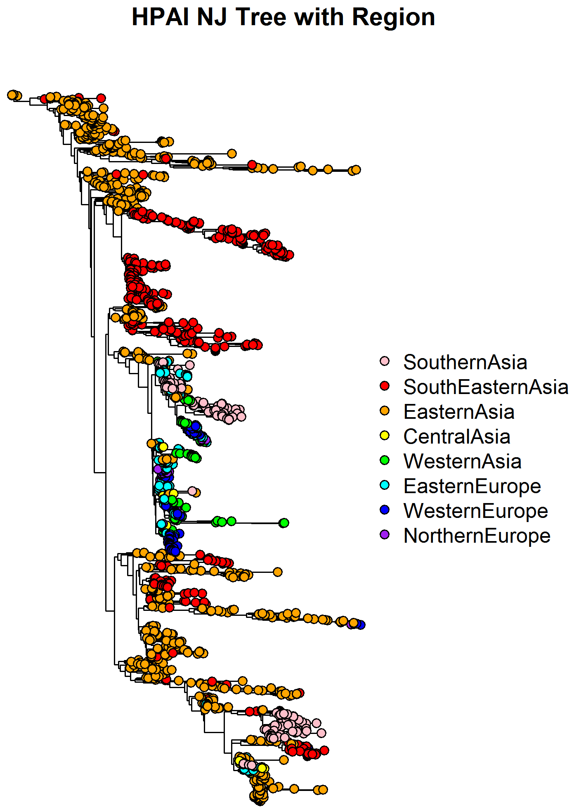
A Brief History of High Path Bird Flu (H5)
HPAI H5N1 circulating in Asia since 1996
Major outbreak in wild birds (Qinghai lake) 2005
Ongoing epidemics in Asia

Slide 35
A Brief History of High Path Bird Flu (H5)
HPAI H5N1 circulating in Asia since 1996
Major outbreak in wild birds (Qinghai lake) 2005
Ongoing epidemics in Asia
Also spread to Europe, Africa and Mediterranean

Slide 36
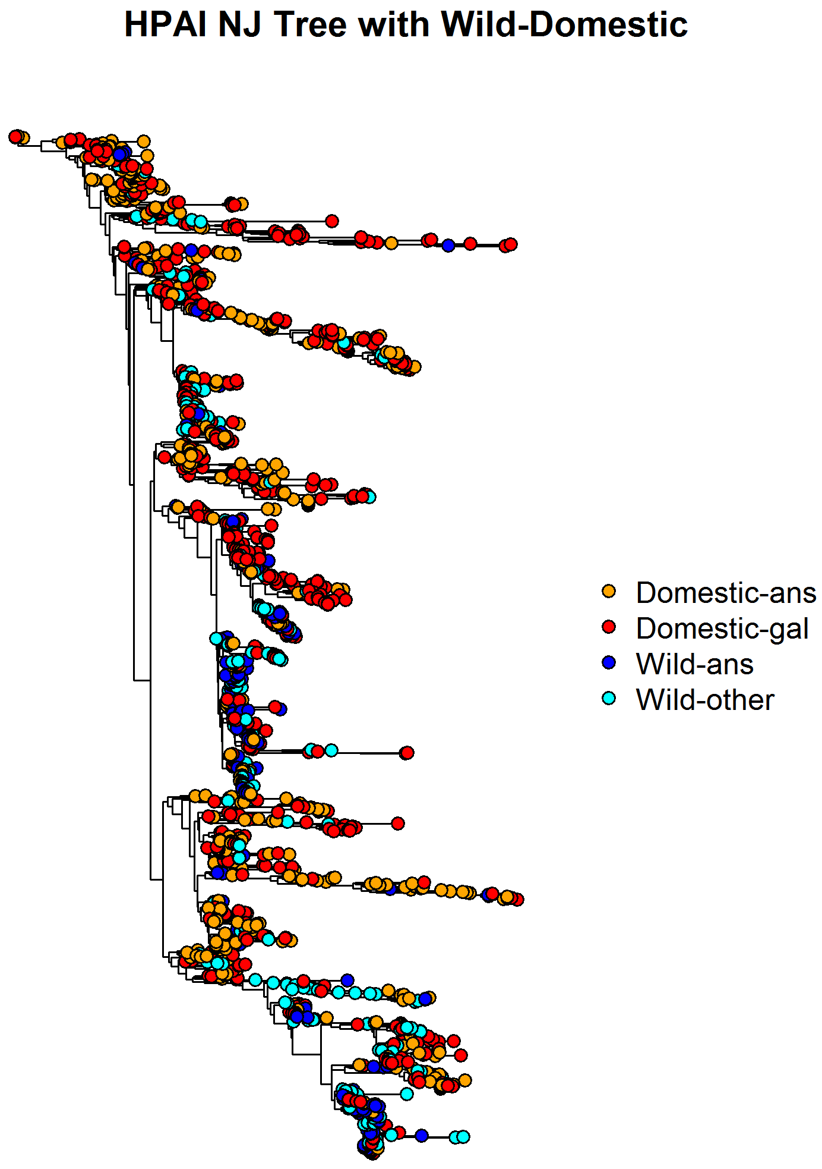
A Brief History of High Path Bird Flu (H5)
HPAI H5N1 circulating in Asia since 1996
Major outbreak in wild birds (Qinghai lake) 2005
Ongoing epidemics in Asia
Also spread to Africa and Mediterranean
Spread between domestic birds, but also to/from migrating wild bird populations
(Different colours from previous slide)

Slide 37
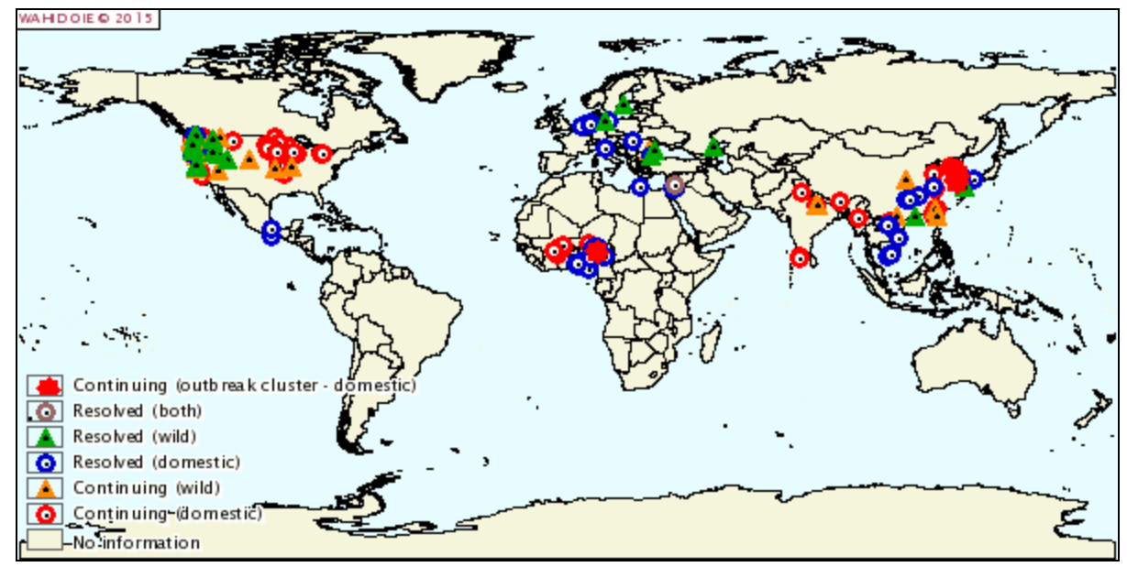
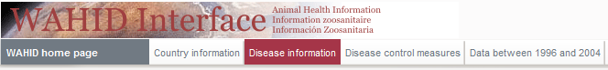
Jan – Apr 2015 (OIE data)
H5N8
H5N8
H5N8
H5N2
Spread more than usual !
Different subtype to usual !

Slide 38
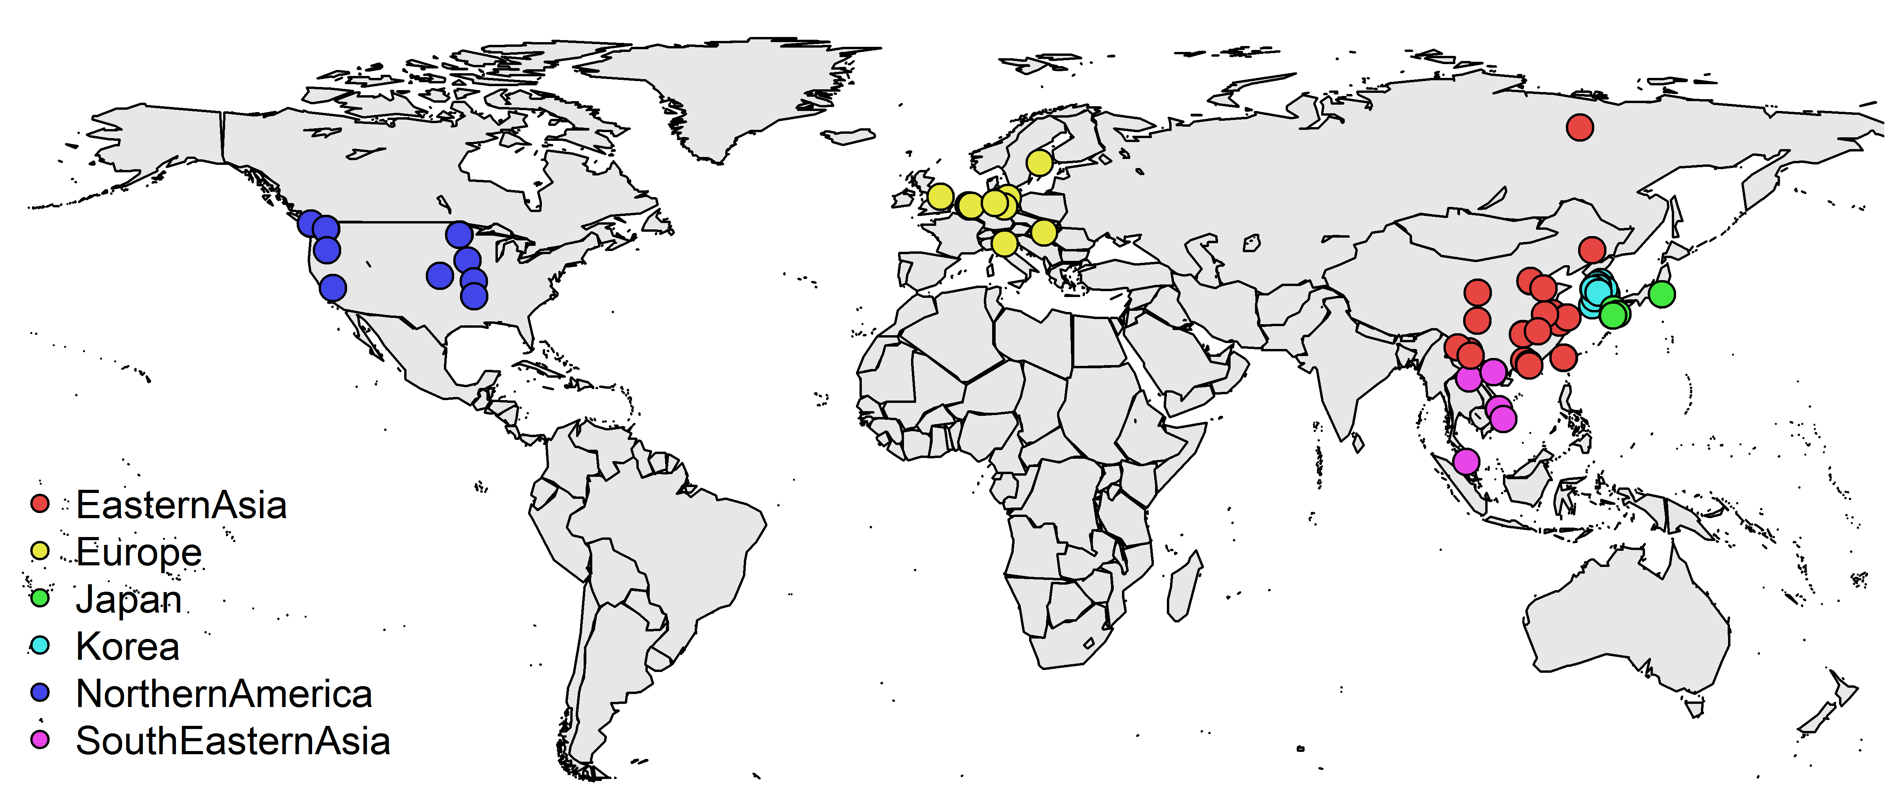
Global Consortium on H5NX
HA sequences 2005-2015: subtypes H5N1, H5N2, H5N3, H5N5, H5N6, H5N8
Deposited with GISAID as part of the Global Consortium on H5N8
Collaborators in 16 countries; Belgium, Canada, China, Germany, Hungary, Italy, Japan, Kenya, Netherlands, Russia, South Korea, Sweden, Taiwan, UK, Vietnam, USA

Slide 39
Outline of analysis
Make trees with traits to find the geographic transmission patterns and which host type is responsible for introductions to Europe and North America
Discrete trait analysis of Hemagglutinin (H5) data with respect to:
  Region (6 types of country or region)
  Host type (4 types of bird)
  Subtype (H5 + 6 types of Neuraminidase)
Use sets of 1000 trees and do discrete trait mapping
  Correlate changes in subtype with respect to Host and Host + Region to find the host type in which the reassortments occur
  Calculate TMRCA and Host type (for the MRCA) for European and North American Sequences
Also use continuous diffusion + Host discrete trait
  Reveals the route of infection - movie (!)

Slide 40
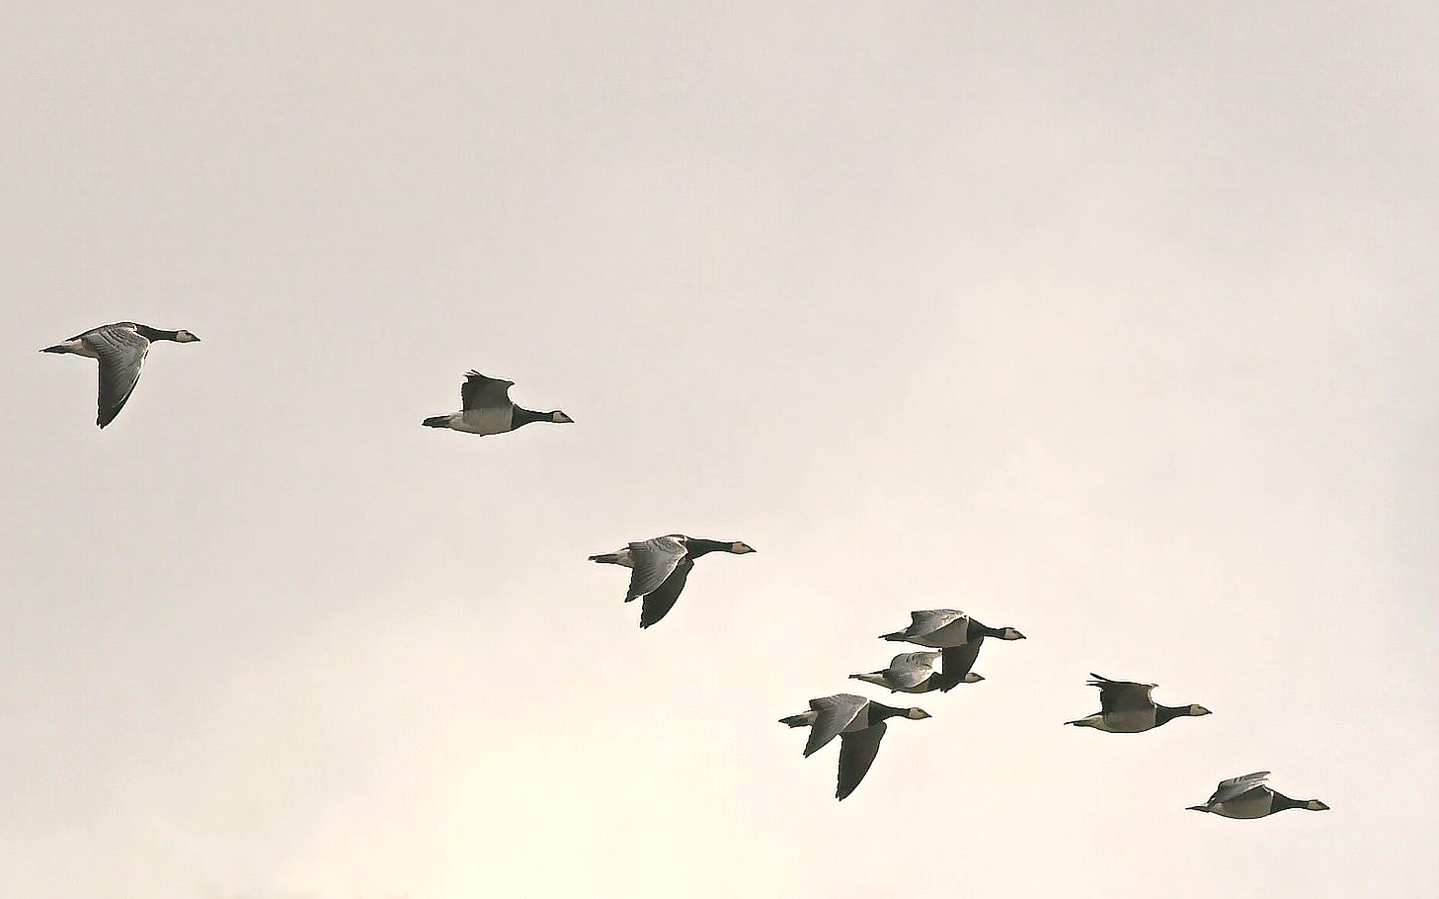
Conclusions
Phylodynamics with traits can be useful !
Predictors for transmission patterns can be identified
Applicable to many systems: Influenza, FMD, Bovine TB, BVD
By Thermos (Own work) [CC BY-SA 2.5 (http://creativecommons.org/licenses/by-sa/2.5)], via Wikimedia Commons

Slide 41

Acknowledgements
Detailed information and sequences from GISAID – and often shared within a week of isolation
Submitting laboratories (H5N8/2):
Global collaboration on H5N8 and related influenza viruses – 16 countries
  Thijs Kuiken (Erasmus Medical Center)
  Mark Woolhouse (University of Edinburgh)
  Martin Beer (Friedrich-Loeffler Institute)
  Ron Fouchier (Erasmus Medical Center)
Animal and Plant Health Agency (APHA), UK
Friedrich-Loeffler-Institut, Germany
Erasmus Medical Center, Netherlands
Central Veterinary Institute, Netherlands
State Research Center of Virology and Biotechnology Vector, Russian Federation
Istituto Zooprofilattico Sperimentale Delle Venezie, Italy
National Institute of Animal Health, Japan
Kagoshima University, Japan
Animal and Plant Quarantine Agency, Korea
National Institute of Environmental Research, Korea
Institute of Microbiology, Chinese Academy of Sciences, China
National Veterinary Services Laboratories, USA
National Centre for Foreign Animal Disease, Canada

Slide 42











Acknowledgements
Mark Woolhouse
Andrew Rambaut
Lu Lu
Matthew Hall
Andrew J. Leigh Brown
Emma Hodcroft
Manon Ragonnet-Cronin
Mojca Zelnikar
Florian Duchatel
Rowland Kao
Thomas Doherty
Jessica Enright
Sibylle Mohr
Anthony O’Hare
Ruth Zadoks
George Russell

Slide 43
Thank you !
Samantha.Lycett@ed.ac.uk

